Slide 1
Push Pull Move
Forces
and
Motion
Diagram Scenarios
Notes:
As a class, use diagrams to discuss pairs of forces and results. (unmoving/moving, which direction, is it a push or a pull?) How do we know?
Show a scenario to the class.
(Provide a few seconds for students to think)
Ask a few students to tell about what they see in the picture.
Tell students-Use your thumbs to show me the direction of the forces.
(Do a quick scan to gauge student thinking)
Now ask students to think about which direction the object in the picture will move.
(Provide a few seconds for students to think)
Tell students-Use a thumb to show me the direction the object will move.
If it will not move, cross your arms over your chest.
Ask several students to share their thinking.
What causes the _____ to move (or not move)?
How do we know?
Discuss as many scenarios as reasonable to gauge student understanding. You may choose to identify additional real-world scenarios for student discussion.

Slide 2
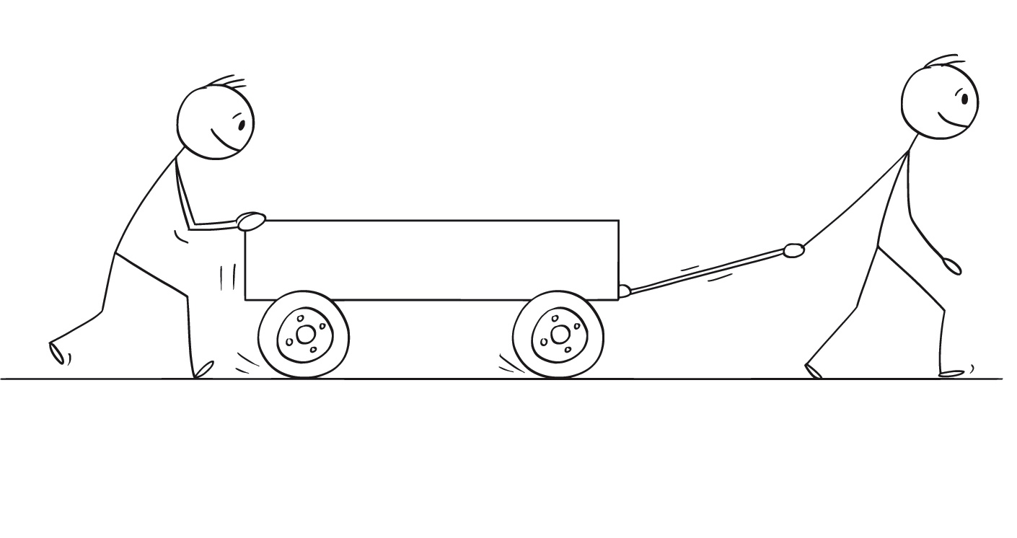
Notes:
What do you see?
Direction of forces?
Are they pushes or pulls?
Object moving/unmoving?
Which direction?
How do we know?

Slide 3

Notes:
What do you see?
Direction of forces?
Are they pushes or pulls?
Object moving/unmoving?
Which direction?
How do we know?
One person is pushing. One person is pulling.
Both forces are in the same direction.
The wagon will move to the right because the people are working together.
The wagon looks like it is empty so neither person will need to work very hard to make it move. (To move light objects, less force is needed.)
Less force=shorter force arrows

Slide 4
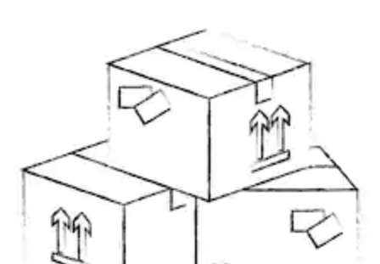
Notes:
What would change if the wagon was filled with with boxes of books?

Slide 5
Notes:
What would change if the wagon was filled with with boxes of books?
To move heavy objects, more force is needed.
Each person will need to work harder (use more effort) to make the wagon move.
More force=longer force arrows

Slide 6
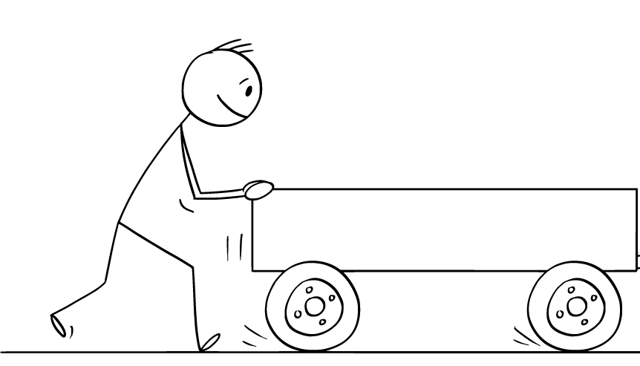
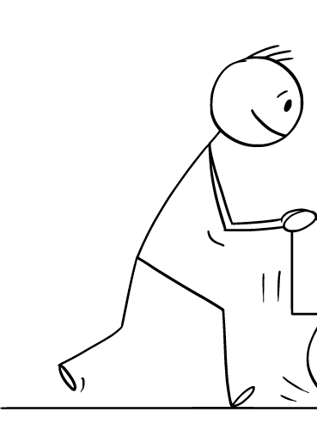
Notes:
What do you see?
Direction of forces?
Are they pushes or pulls?
Object moving/unmoving?
Which direction?
How do we know?

Slide 7
Notes:
What do you see?
Direction of forces?
Are they pushes or pulls?
Object moving/unmoving?
Which direction?
How do we know?
Both people are pushing.
The forces are the same strength but in opposite (different) directions.
The wagon will not move because the people are working against each other.

Slide 8
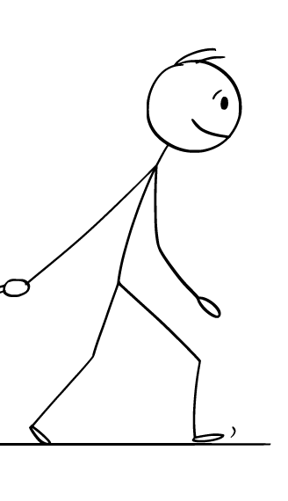
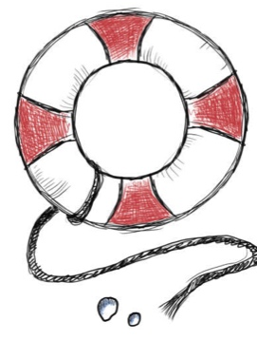
Notes:
What do you see?
Direction of forces?
Are they pushes or pulls?
Object moving/unmoving?
Which direction?
How do we know?

Slide 9
Notes:
What happens when one person can pull with more force than the other person? (longer arrow)
What do you see?
Direction of forces?
Are they pushes or pulls?
Object moving/unmoving?
Which direction?
How do we know?
Both people are pulling.
Both forces are in opposite (different) directions.
One force is bigger than the other (longer arrow)
The life preserver will move to the right because that is the direction of the stronger force..

Slide 10
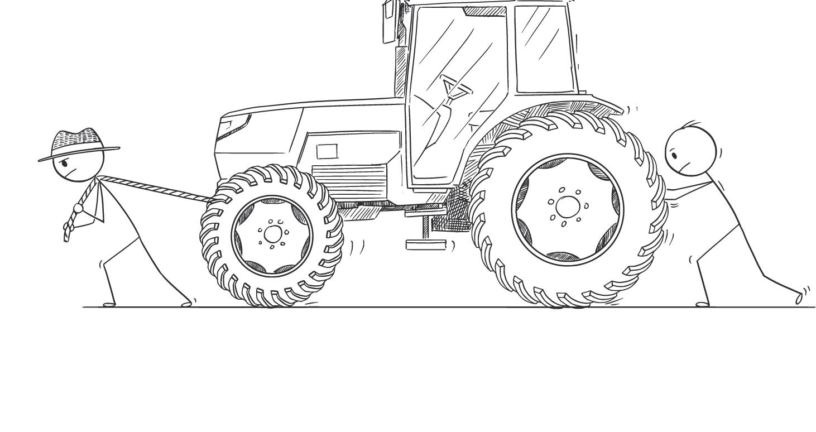
Notes:
What do you see?
Direction of forces?
Are they pushes or pulls?
Object moving/unmoving?
Which direction?
How do we know?

Slide 11
Notes:
What do you see?
Direction of forces?
Are they pushes or pulls?
Object moving/unmoving?
Which direction?
How do we know?
One person is pushing. One person is pulling.
Both forces are in the same direction.
The tractor should move to the left because the people are working together.
However, it is possible that because the tractor is very heavy that even working to might not be enough to make it move.
Sometimes you can use a lot of force to try to move an object, but it does not move much or at all.

Slide 12
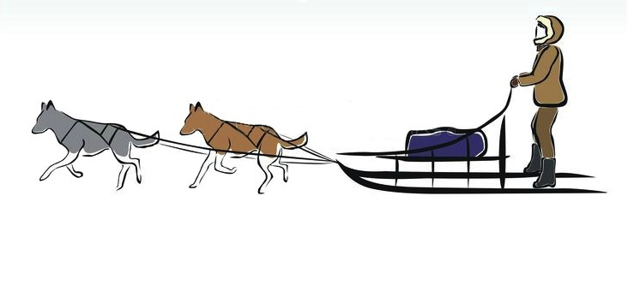
Notes:
What do you see?
Direction of forces?
Are they pushes or pulls?
Object moving/unmoving?
Which direction?
How do we know?

Slide 13
Notes:
What do you see?
Direction of forces?
Are they pushes or pulls?
Object moving/unmoving?
Which direction?
How do we know?
Both dogs are pulling.
Both forces are in the same direction.
The sled will move forward (to the left) because the dogs are working together.
You can tell from the small bundle on the sled that the rider was careful not to pack too much on the sled.
What would happen if the rider added more to the bundle?
To move heavy objects, more force is needed.
Each dog will need to work harder (use more effort) to make the sled move.

Slide 14


Slide 15
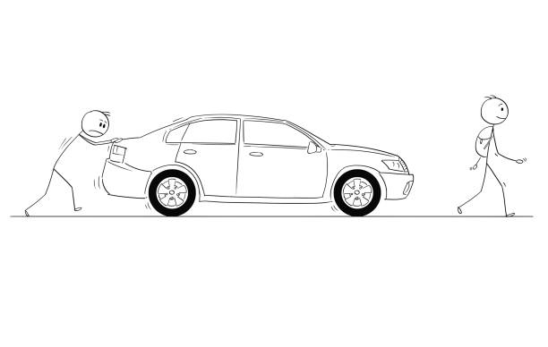
Notes:
What do you see?
Direction of forces?
Are they pushes or pulls?
Object moving/unmoving?
Which direction?
How do we know?

Slide 16
Notes:
Why is one person smiling and the other is not?
What do you see?
Direction of forces?
Are they pushes or pulls?
Object moving/unmoving?
Which direction?
How do we know?
The frowning person (pushing the car) is working very hard.
The smiling person (is not helping)

Slide 17
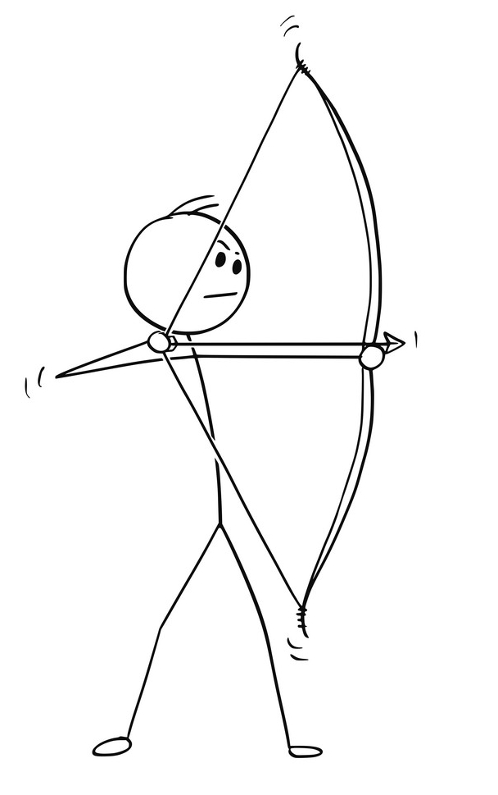
Notes:
What do you see?
Direction of forces?
Are they pushes or pulls?
Object moving/unmoving?
Which direction?
How do we know?

Slide 18
Notes:
What do you see?
Direction of forces?
Are they pushes or pulls?
Object moving/unmoving?
Which direction?
How do we know?
The person is pulling back on the string of the bow.
The string of the bow is pulling in the opposite direction.
In this case, the forces are balanced…the arrow cannot move until the person quits pulling (lets go)
What will happen when the person lets go of the string?
When the person lets go, the arrow will move forward (to the right) the string will give it a push.

Slide 19
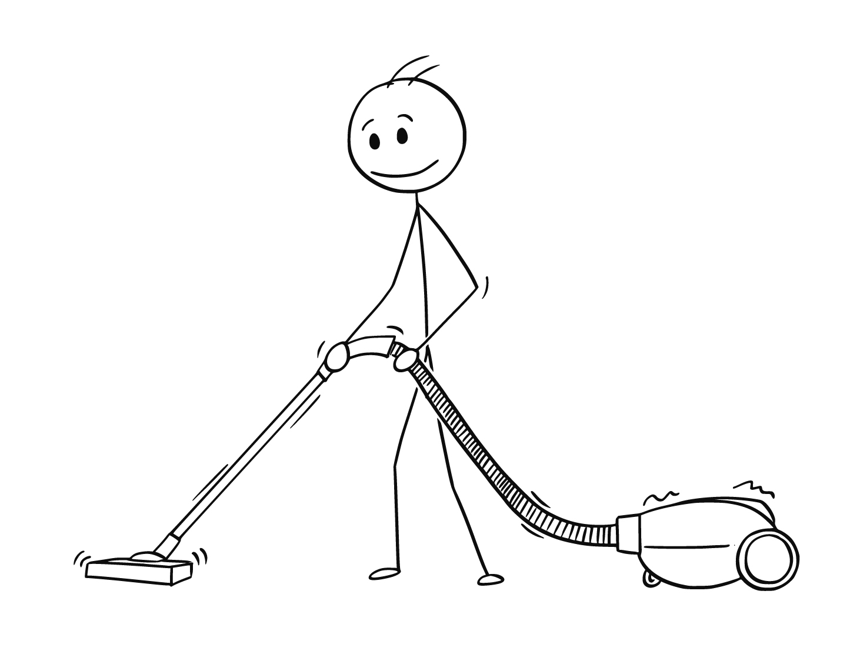
Notes:
What do you see?
Direction of forces?
Are they pushes or pulls?
Object moving/unmoving?
Which direction?
How do we know?

Slide 20
Notes:
What do you see?
Direction of forces?
Are they pushes or pulls?
Object moving/unmoving?
Which direction?
How do we know?
There are many stories to be told by this picture.
One scenario is that the person is pushing the vacuum wand and pulling the canister at the same time (which would produce movement to the left- forward)
It would also be possible to push the wand forward a bit, then pull back the same amount. This bac and forth motion

Slide 21

Notes:
What other examples do you have? (push pull move)

