Slide 1

Notes:
Which is easier to move?
Which is harder to move?
Why?

Slide 2
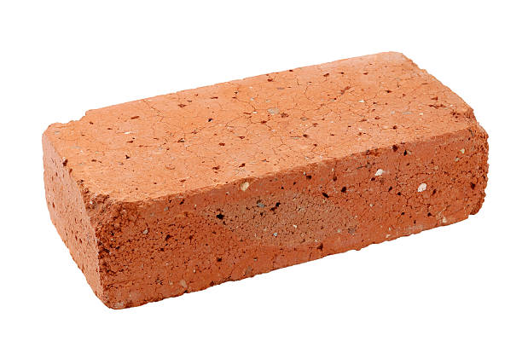
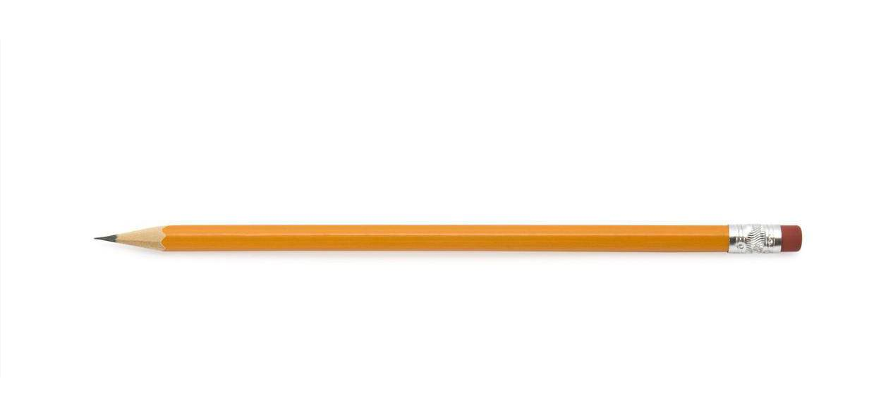
Notes:
Which is easier to move?
Pencil
Why?
Light objects are easy to move, but heavy objects are harder (more difficult) to move.
To move heavy objects, greater force is needed.
To move light objects, less force is needed.
Push or pull?
Pull- pick up
Push- move away
Pull- move toward

Slide 3


Notes:
Which is easier to move?
Pebble
Why?
Light objects are easy to move, but heavy objects are harder (more difficult) to move.
To move heavy objects, greater force is needed.
To move light objects, less force is needed.
Push or pull?
Pull- pick up (probably would not try to pick up an elephant)
Push- move away
Pull- move toward

Slide 4


Notes:
Which is easier to move?
Beach ball
Why?
Light objects are easy to move, but heavy objects are harder (more difficult) to move.
To move heavy objects, greater force is needed.
To move light objects, less force is needed.
Push or pull?
Push- to roll
Push- to kick (beach ball only)
Pull- pick up
Push- move away
Pull- move toward

Slide 5


Notes:
Which is easier to move?
Cat
Why?
Light objects are easy to move, but heavy objects are harder (more difficult) to move.
To move heavy objects, greater force is needed.
To move light objects, less force is needed.
Push or pull?
Pull- pick up (probably would not try to pick up an elephant)
Push- move away
Pull- move toward

Slide 6

Notes:
Which is easier to move?
Short stack
Why?
The more books, the heavier the stack becomes. The heavier that stack becomes, the more force is needed to move the stack.
Even if the individual books are light the combined weight adds up.
Force comes in different amounts. To make something move, sometimes you need a lot of force, sometimes just a little force.
Push or pull?
Pull- pick up
Push- move away
Pull- move toward

Slide 7

Notes:
What other examples can you think of?

