Slide 1
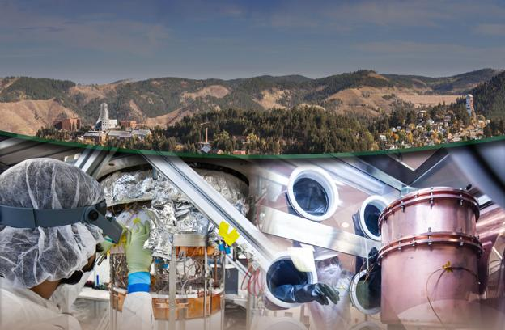

A Deep Habitat for Science
Notes:
Today you are going to learn what it is like at the Sanford Underground Research Facility (SURF)… A science laboratory almost a mile below the surface of the earth!

Slide 2
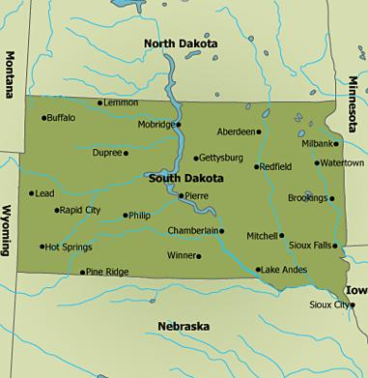
Lead
Notes:
The Sanford Underground Research Facility (SURF) is located in the Black Hills of South Dakota, in Lead, near the Wyoming border. The facility was constructed in the former Homestake gold mine- the largest, deepest, and most productive in the US.
It operated as a gold mine for 125 years! But the gold mine was closed around the year 2001… after mining ~41 million ounces of gold and 9 million ounces of silver.”

Slide 3
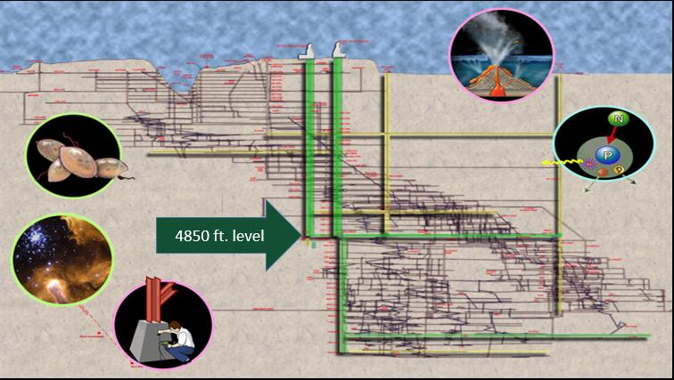
Notes:
Cross-section Map
Imagine that we had x-ray vision and could see through the earth! If we looked beneath the surface in Lead, we would reveal all the underground tunnels and shafts originally created by miners seeking gold. The structure extends to a depth of 1.5 miles, and there are over 370 miles of tunnels.
When the gold mine announced it was closing, scientists asked if it could be repurposed into a giant underground science laboratory, and the Sanford Underground Research Facility is what exists here today. The activities taking place are very diverse and include physics, astrophysics, geology, geotechnical engineering, and even biology! Some of the world’s most sensitive physics experiments have been constructed at a depth of almost one mile on the 4850’ level.

Slide 4
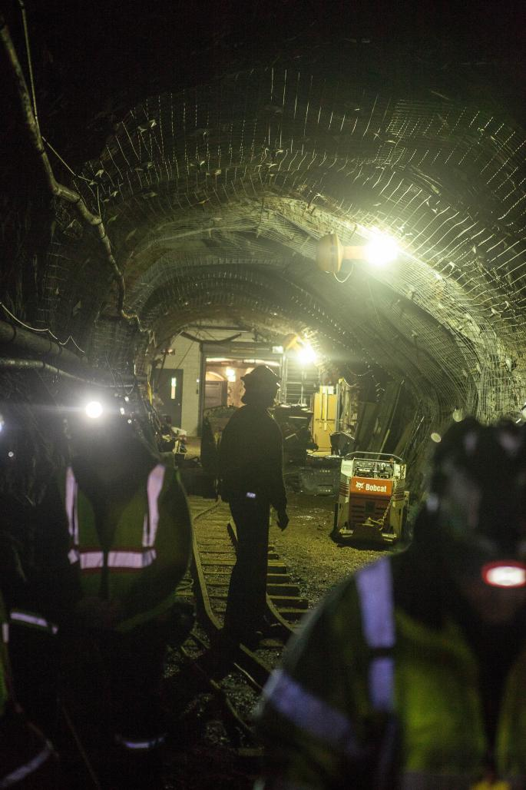
It’s dark
Notes:
Much of the underground habitat of SURF is similar to when it used to be a gold mine. The drifts (tunnels) are very dark. Scientists need to bring their own lights to see, and wear reflective clothing so that they can be seen by other scientists and engineers.

Slide 5
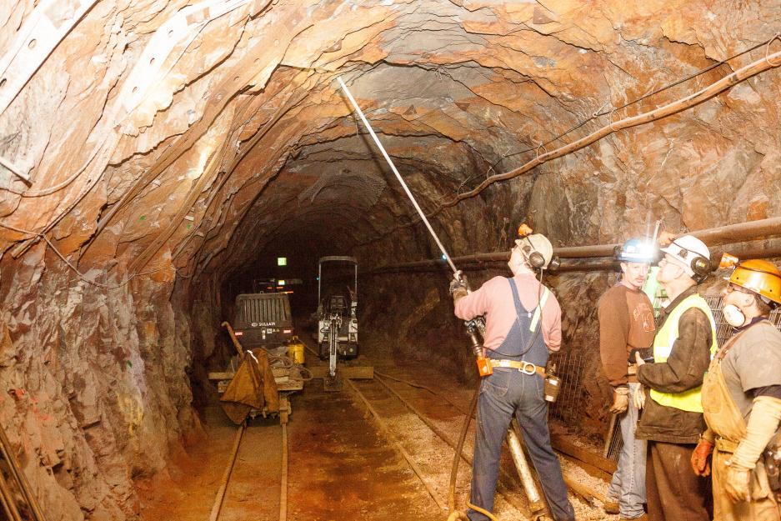
It’s dirty
Notes:
The drifts are also very dirty. Scientists wear coveralls to keep their clothes clean and dry. The walls and ceilings are being inspected (as shown here) for loose rocks. Loose rocks are removed to prevent them from falling on anyone’s head.

Slide 6
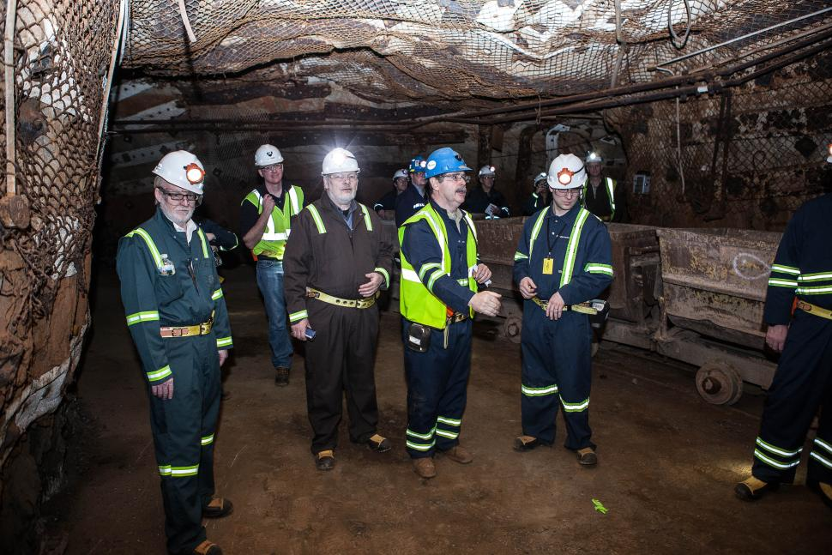
It’s daring
Notes:
Operating a laboratory nearly a mile underground requires a lot of safety equipment, or PPE (short for Personal Protective Equipment). It can be very dark, there is always the chance that rocks might fall on you, and heavy machinery is often being operated. Additionally, the scientific equipment can be very large, complicated, and difficult to access in the tight spaces (or caverns) where they have been installed.
Therefore, scientists and engineers working at the SURF have a lot of challenges to overcome in this deep underground habitat! Here you can see some scientists dressed for work. They wear personal protective equipment (or PPE) for safety.
PPE: 1- Steel toe boots- protect toes
2- Coveralls- keep clothing clean and dry
3- Hard hats- protect heads
4- Safety glasses- protect eyes
5- Cap lights (worn on hard hat) for light
6- Reflective material (on coveralls and safety vests) for visibility

Slide 7
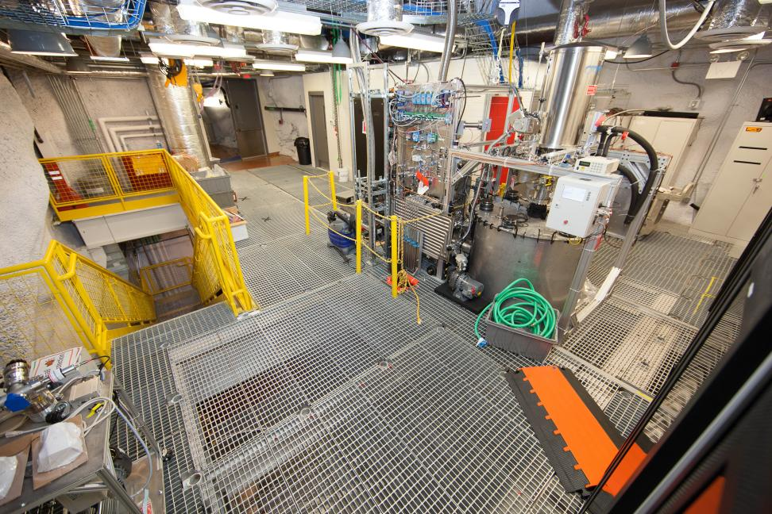
Deep underground laboratory
Notes:
There are also spaces in the deep underground laboratory where it is not dirty. In fact, the laboratories where the most sensitive physics experiments are housed must be incredibly clean. These spaces of the underground laboratory habitat present a different set of challenges.

Slide 8
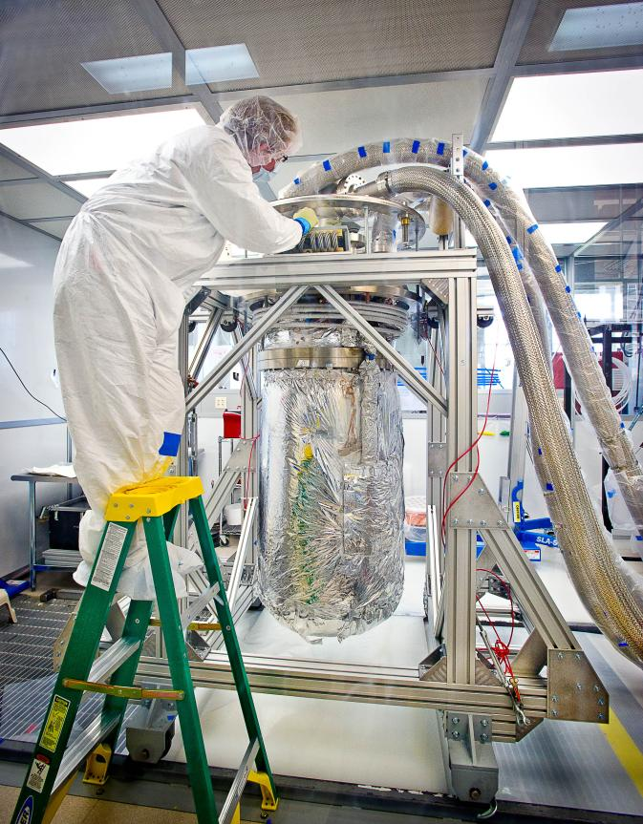
Detector
construction
Notes:
Here is a scientist getting an experiment ready. Notice that this scientist is wearing a white cleanroom (Tyvek) suit, rubber gloves, and hair net. There are even white covers over this scientists shoes! These pieces of equipment protect the sensitive detector from any hair, dirt or oil coming from the scientist. Additionally, this scientist had to use a tall ladder to reach the top of this detector. Some of the physics equipment is even taller, and/or hard to reach in tight spaces.

Slide 9
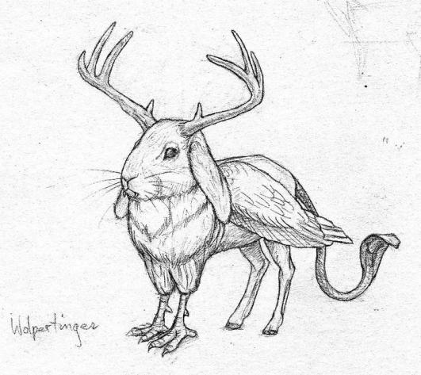
Scientist mashup
Design
Draw or craft
Explain
Notes:
So, as you can tell, the deep underground habitat at SURF is very unique… and presents unique challenges to the scientists working there. Now, I want you to use your imaginations to create a crazy creature mash-up. The goal is to design the perfect underground scientist by combining together different parts of different creatures. The goal is to create a scientist able to meet the challenges of working in the deep underground laboratory habitat with little or no personal protective equipment (PPE).
For instance, a creature with eyes that can see well in the dark would be well suited to the dark tunnels, but you might ONLY want those eyes. You could then combine those eyes with the body of a creature able to spin a silken thread (web) so that there is no danger of falling off of a ladder. If you look at the picture shown, this creature has the head of a rabbit, wings of a bird, and hind legs of a goat. Each of these different parts gives this imaginary creature different advantages. Be creative and have fun!
Once you imagine your perfect underground scientist, you may draw or use craft supplies to create a model. Then, you will take turns sharing your models. Explain how each individual part helps your scientist meet one or more challenges of working in the deep underground habitat at SURF.

