Slide 1

Forces at Work
Underground Research Facility
Notes:
Sanford Underground Research Facility--SURF
The Sanford Underground Research Facility in Lead, South Dakota, is an underground science laboratory built in the former Homestake gold mine. SURF hosts a variety of science experiments. Some of the largest physics experiments, in dark matter and neutrino research, are located nearly one mile underground (4850 feet) to protect sensitive equipment from cosmic rays that can interfere with their results.

Slide 2
Where do you see pushes or pulls?
How do these forces help get work done?

Slide 3
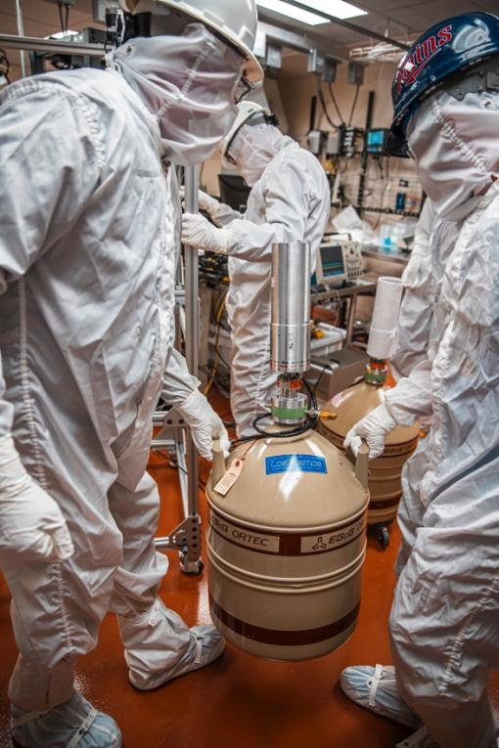

Slide 4
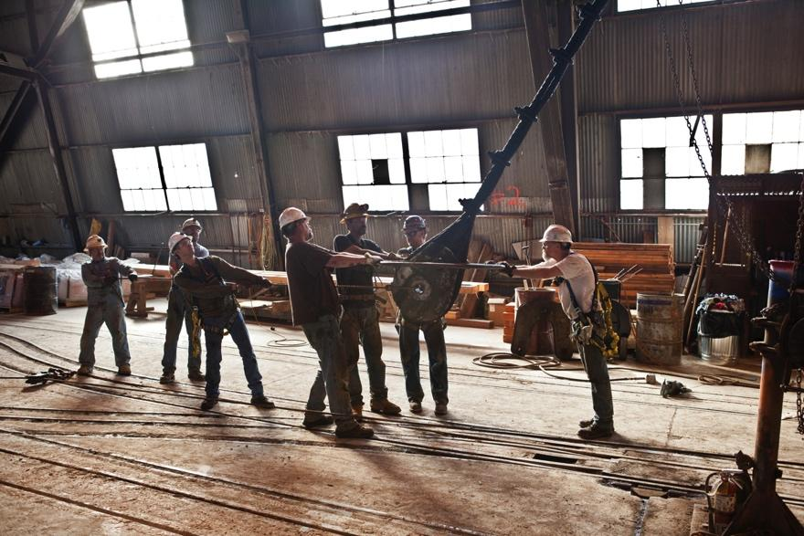

Slide 5
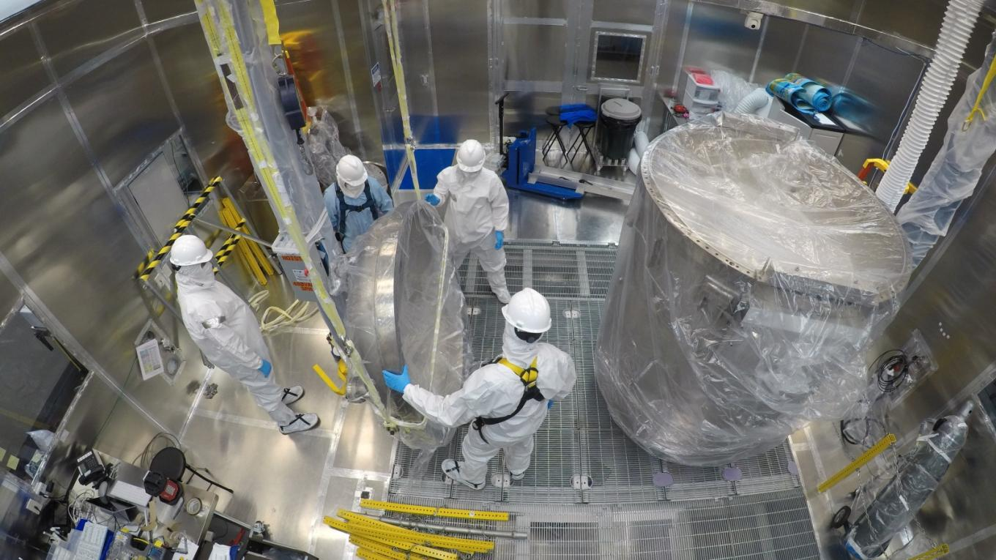

Slide 6
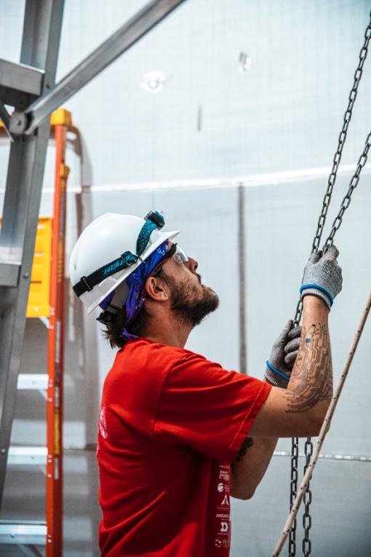

Slide 7
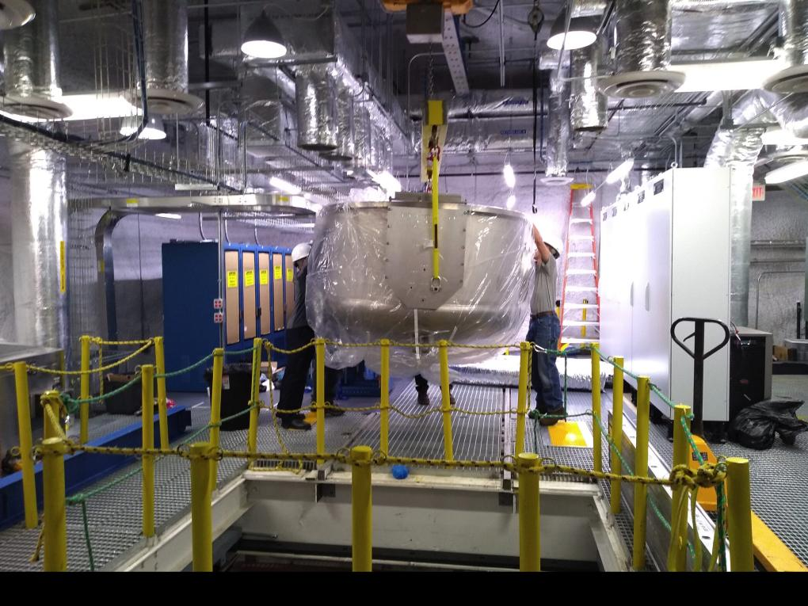

Slide 8
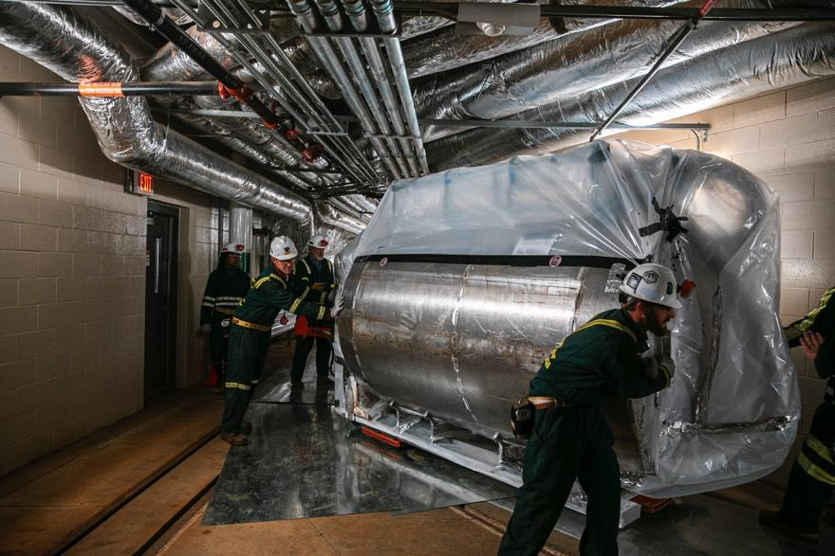

Slide 9
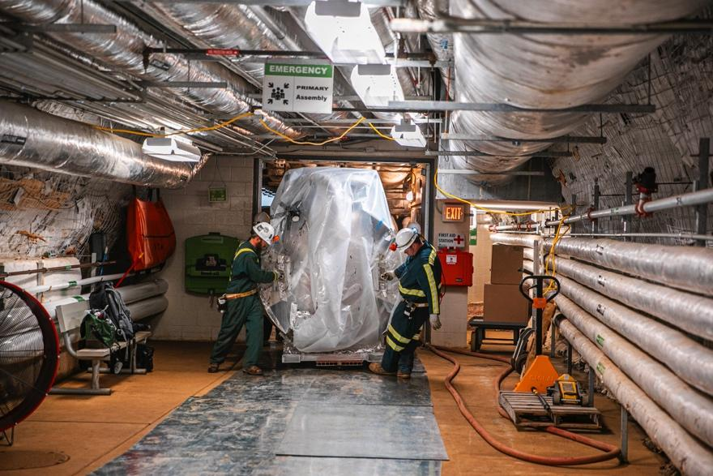

Slide 10
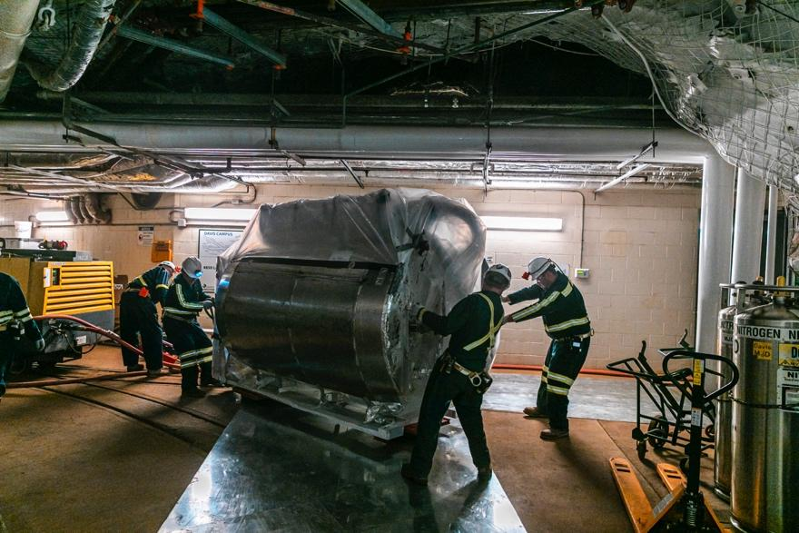

Slide 11
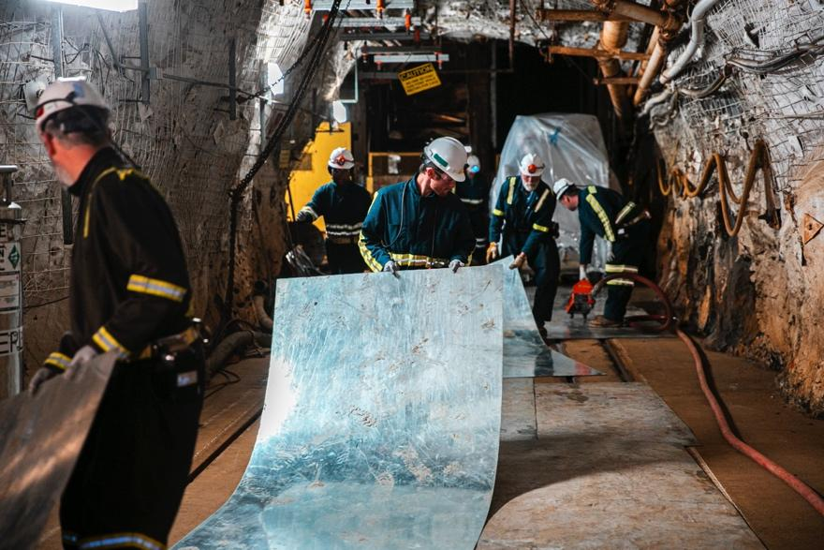

Slide 12
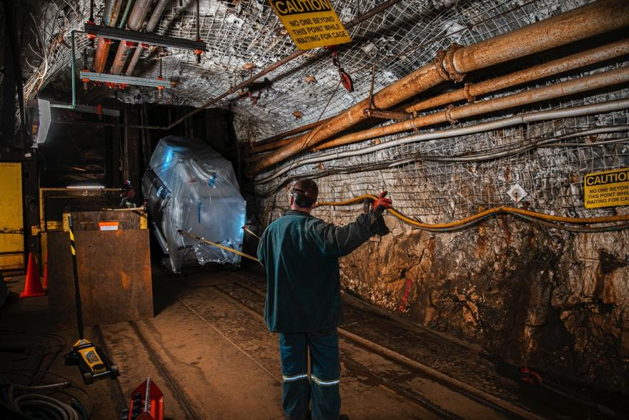

Slide 13
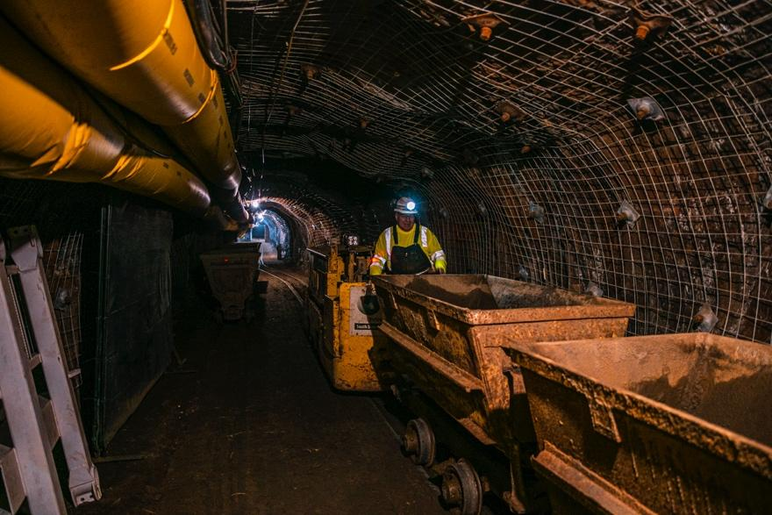

Slide 14
