Slide 1


Lesson 4
Yates Hoist

Slide 2
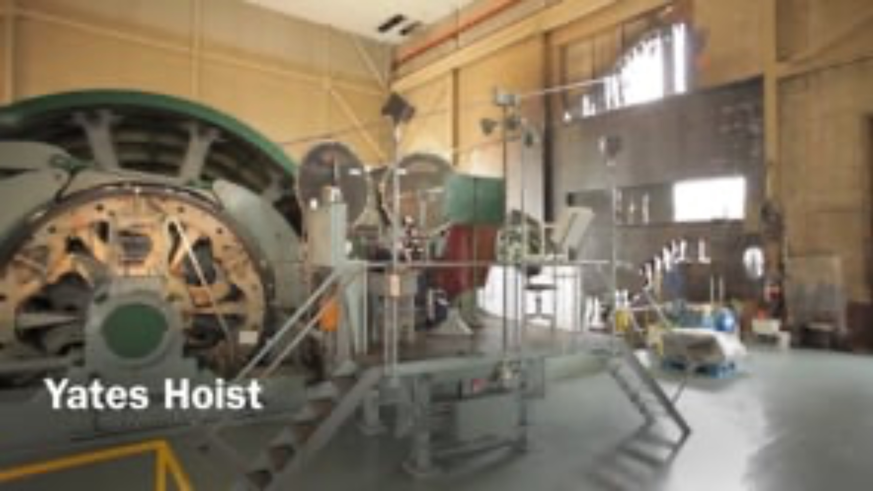

Slide 3
