Slide 1

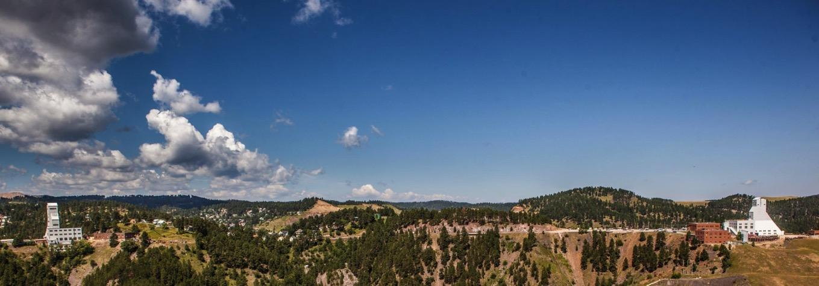
Notes:
Sanford Underground Research Facility (SURF), located in the former Homestake Gold Mine in Lead, South Dakota, hosts world-leading research experiments in physics, biology, geology, and engineering.

Slide 2
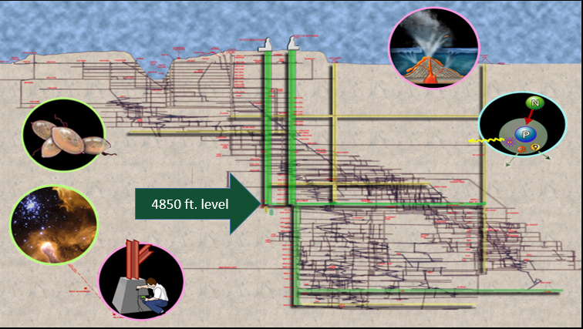
Deep Science: Biology, Astrophysics, Engineering, Geology, Physics
Notes:
The facility below your feet…
Imagine that we had x-ray vision and could peer inside the earth. We would see this cross-section.
There are over 370 miles of tunnels (drifts) underground.
Most of the science is happening at the 4850 ft level (nearly one mile underground)
How do you think we get there? (provide a few moments for each student to quietly think about this)
(turn and talk to a neighbor) Discuss a few ideas before continuing

Slide 3
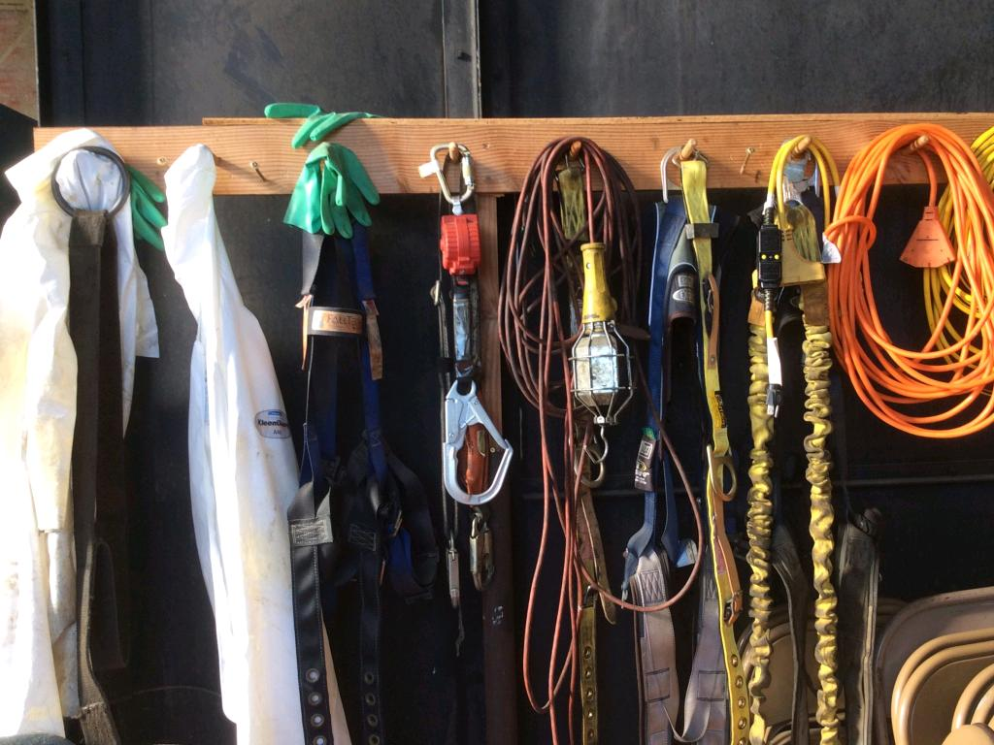
DESIGN CHALLENGE
Notes:
Today we have a challenge for you!
You will be working to design and build an apparatus for the people at SURF to get from the underground back to the surface :0)
Raise your hand if ever designed/built something?
What are some of the things that you need to do before you build?
Discuss a few suggestions before explaining process

Slide 4
Engineering Design Process
Test
Identify
Imagine
Design
Create
Share
Improve
For engineers, the design process is a series of steps that helps teams frame and solve complex problems.

Slide 5
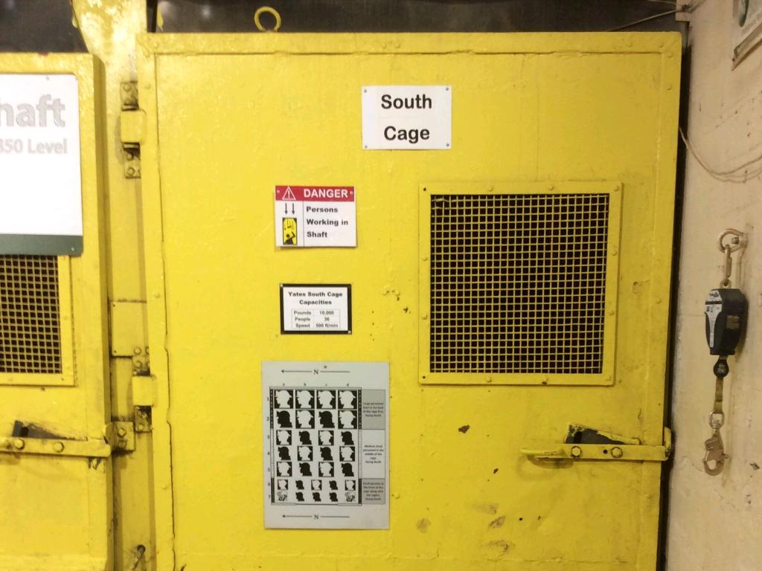
A LOAD TO CARRY
Safe transportation of people and equipment
Notes:
Hoist Engineering Challenge
Use the engineering design process (and a bit of creativity) to design, test, and build a system that is capable of lifting a load (the cage) up a shaft.
Your design must also include some sort of brake that will hold the load at the top of the shaft.
This would allow for safe unloading of the cage at the top of the shaft (surface).

Slide 6
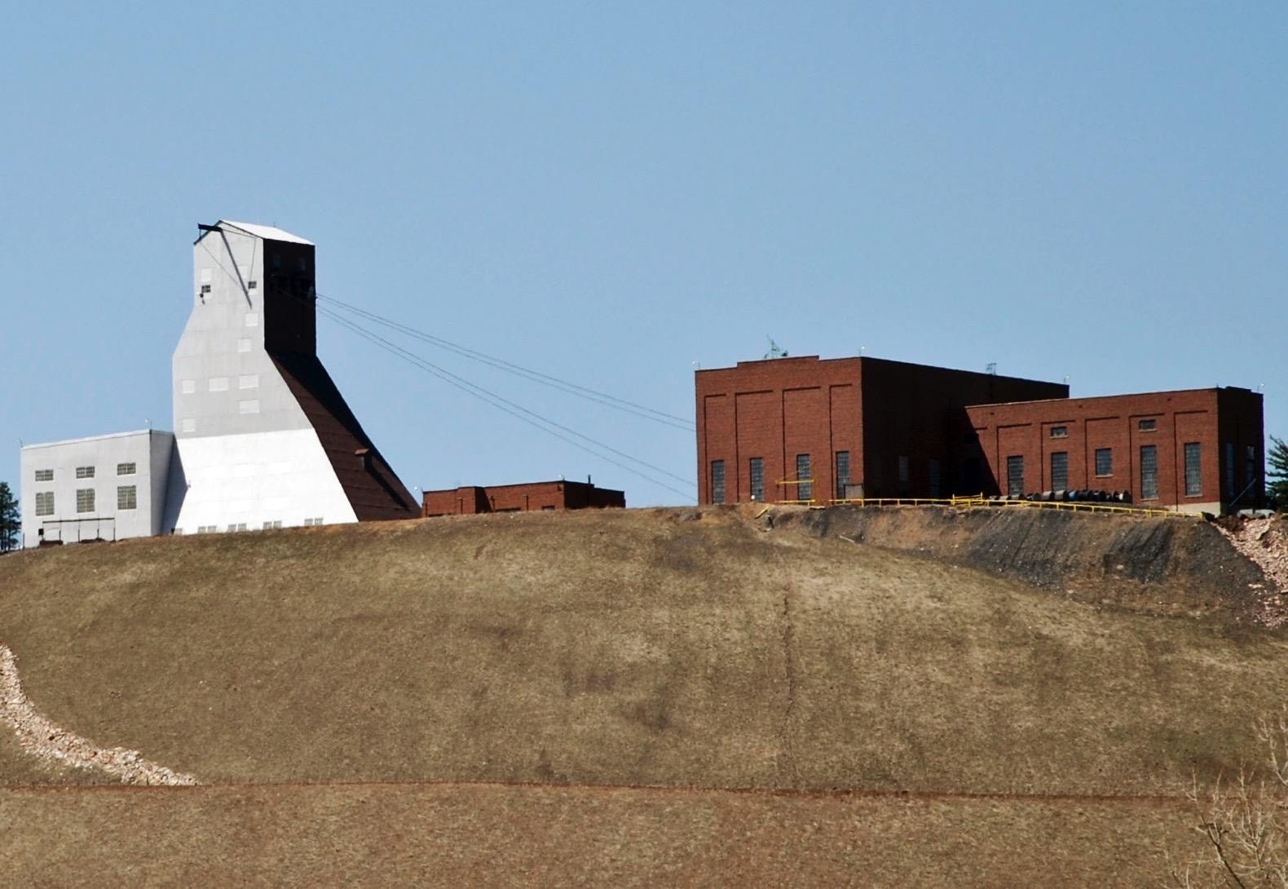
Headframe
Wire “Ropes”
Hoist Room
Cage
Shaft
Notes:
This is a basic diagram of our system…..
What do you notice? What do you wonder? What does this system remind you of?
What are the major components? How could you represent them with materials you have at school/home?
Raid the recycle bin!
Ropes… kite string, yarn, dental floss, ribbon, shoelace, fishing line, etc
Cage… Small bathroom cup, small yogurt cup, metal washer (anything that you can use as a weight that can be connected to a string.)
Shaft… paper towel tube, rolled up newspaper, stack of cups, rules or sticks…(tall and strong enough to support the cage.)
The machinery that provides the power is in the hoistroom where you cannot see it (yet)
At school or home- you will provide the power by pulling the ‘rope’.
What do you think the blue circle represents?
Sheave wheel- a big round wheel- keeps the rope from bending at a severe angle over the top of the shaft- too much friction will destroy the rope ☹
What about the load? Where does it travel?
Typically, inside the shaft- but since it could be a challenge to find a something hollow.
And if you do…it needs to be big enough inside for the load (so, a straw for example might not be the answer)- the model you build might end up more like a tower . (all depends on what you can find)

Slide 7
YOUR CHALLENGE
Use any materials you can find to build a system that is capable of lifting a load (the cage) up a shaft.
Your design must also include some sort of brake that will hold the load at the top of the shaft.
Notes:
What questions do you have about the challenge?
If you are looking for questions to help students move forward or get unstuck, see file- Questions to help Students Get Unstuck for inspiration

Slide 8

Notes:
I encourage you to share your design journey with someone at home (practice telling your story)
Next week….Share designs with your classmates.
Which building materials did you choose?
Was it necessary to revise your original design idea? If so, which of your designs performed the best?
Now that you have some experience, what might you change?
Now that you have shared your findings with each other how might you select certain aspects from multiple designs and combine them to create a super structure?

Slide 9
Part 2

Slide 10
Notes:
Last week designed/built.
Ready to Share??
Which building material did you choose?
Was it necessary to revise your original design idea? If so, which of your designs performed the best?
Now that you have some experience, what might you change to optimize shielding?
Now that you have shared your findings with each other how might it be possible to select certain aspects from multiple designs and combine them to create a super structure?

Slide 11
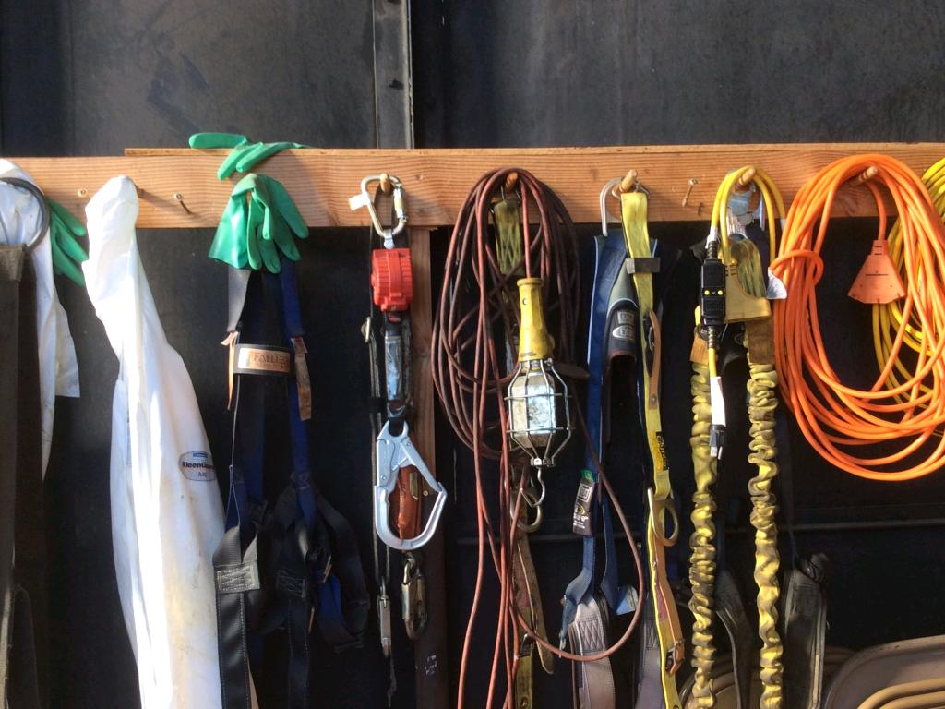
OUR HOIST SYSTEM

Slide 12
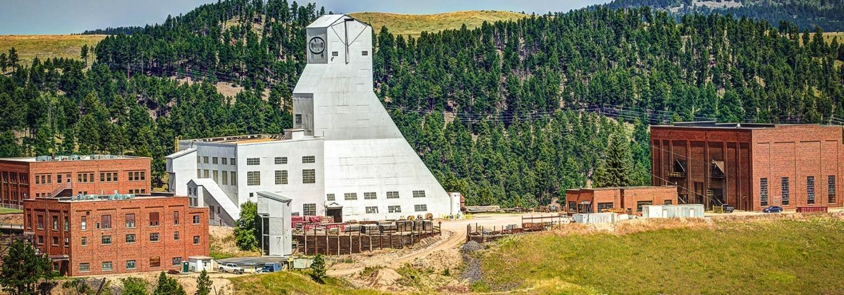
Notes:
Ready to see what is inside the hoistroom? (far right brick building)
Read more about it.
https://sanfordlab.org/news/how-it-works-yates-hoistroom

Slide 13
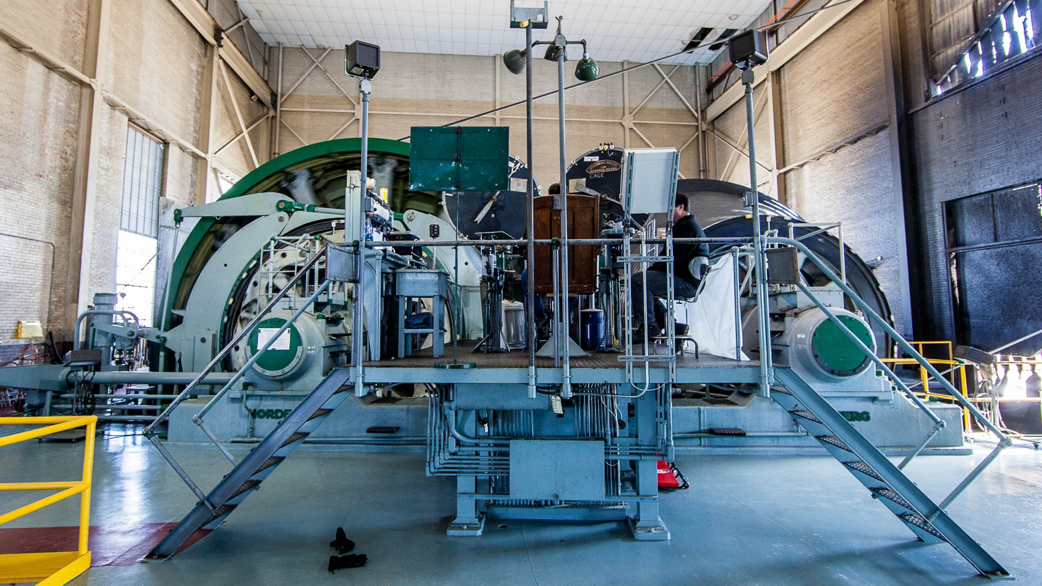
Notes:
(click picture to view video)
It takes a lot of energy to move a cage filled with people or equipment up and down the shaft. Two motors power the cage hoists each capable of 1250 horsepower. That's three times the horsepower of an average sports car!
https://vimeo.com/458273951

Slide 14
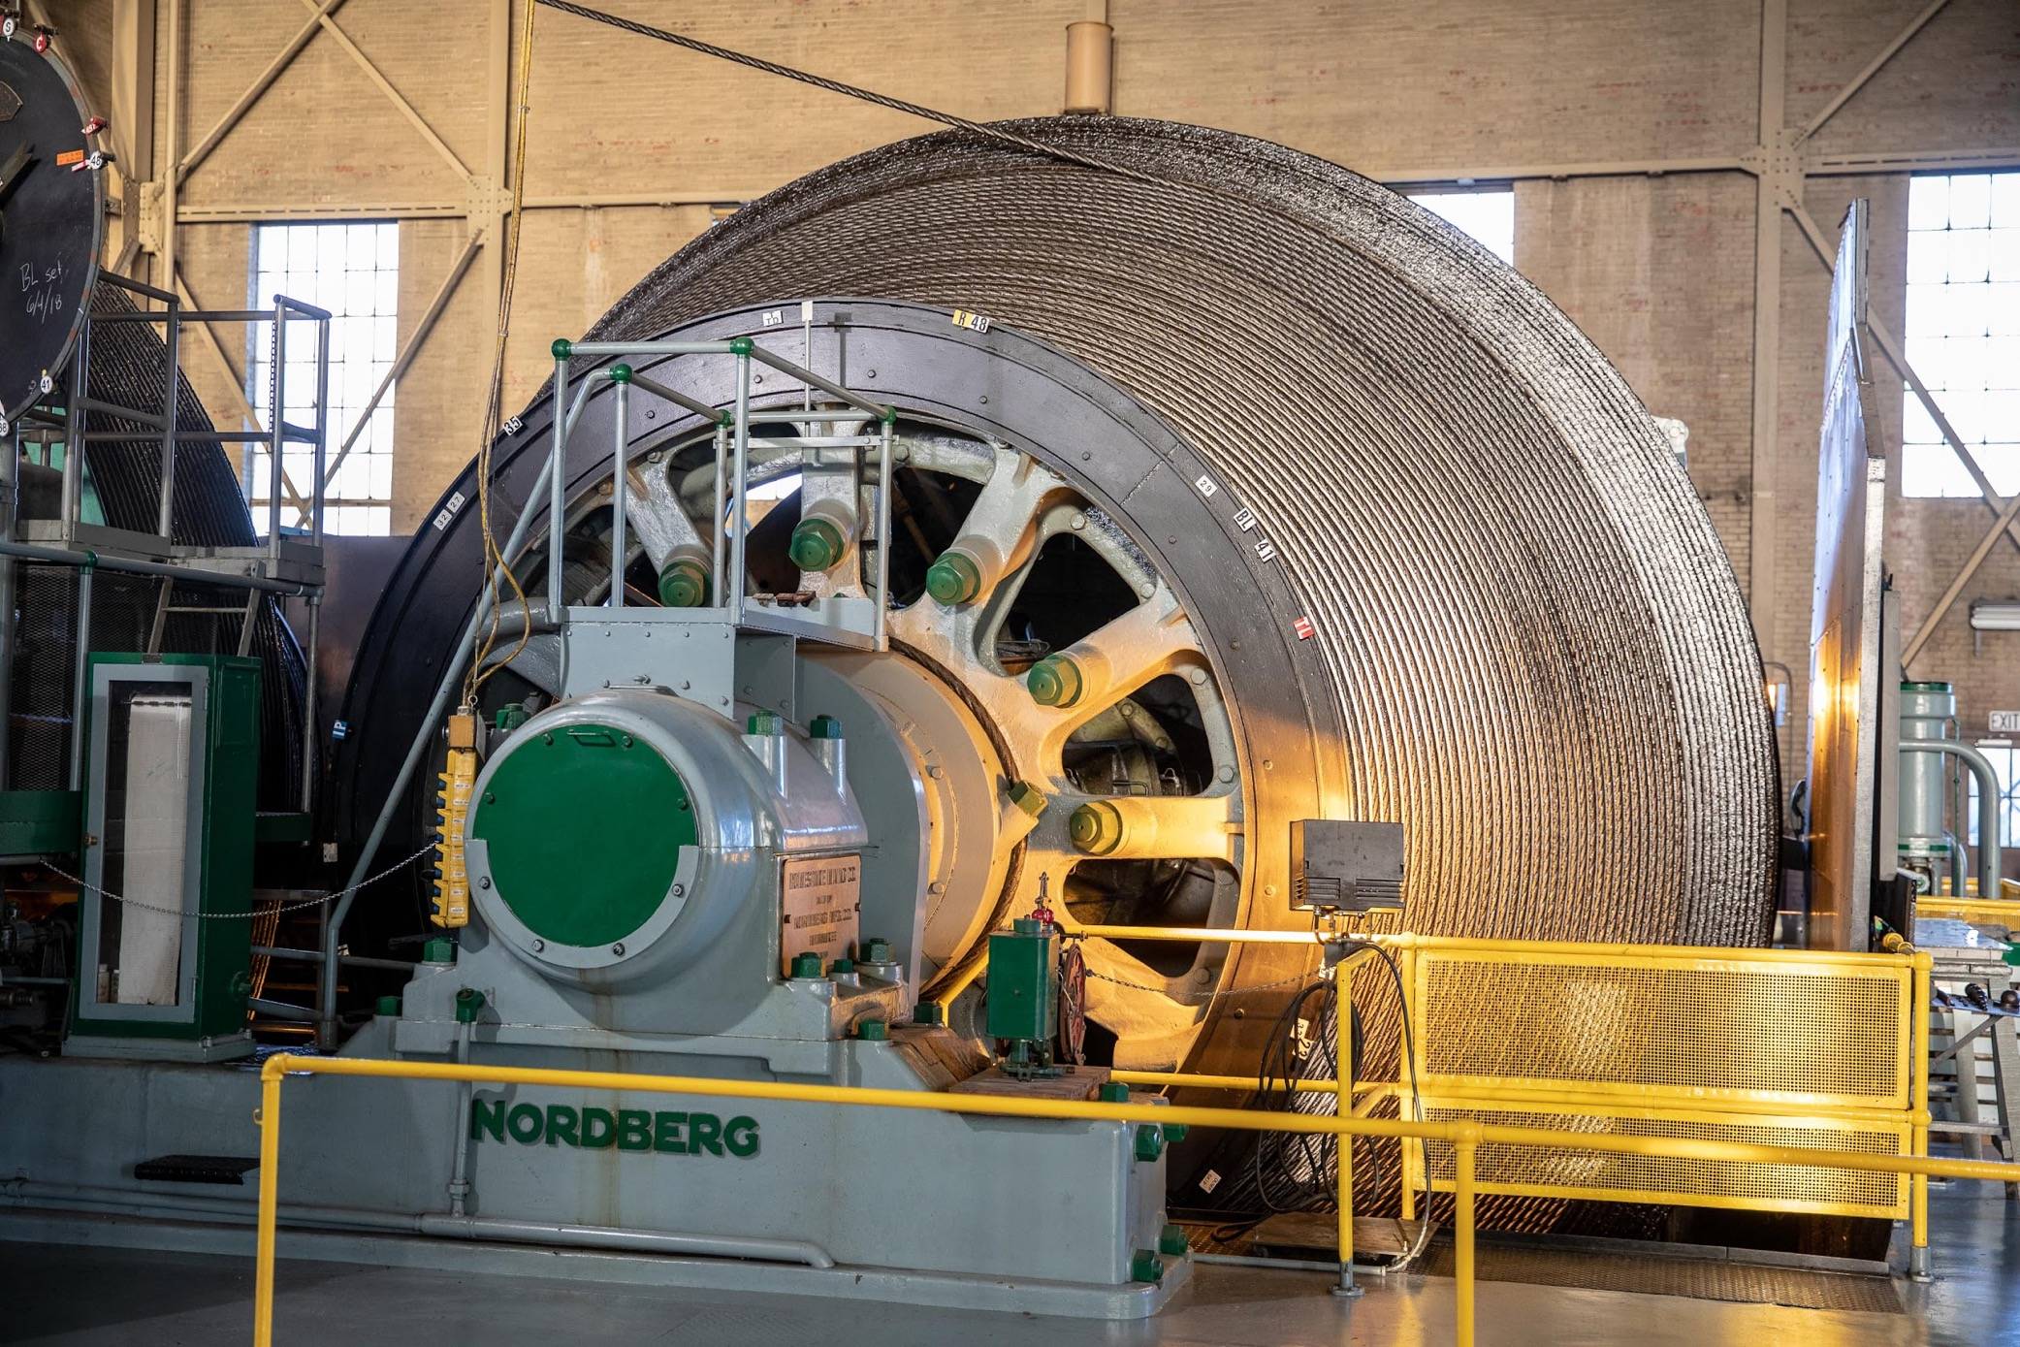
Notes:
This is one of the drums on the hoist.
(click picture to view video)
Watch the drum on the right as the rope is wound.
What do you notice?
What do you wonder?
https://vimeo.com/458274093

Slide 15
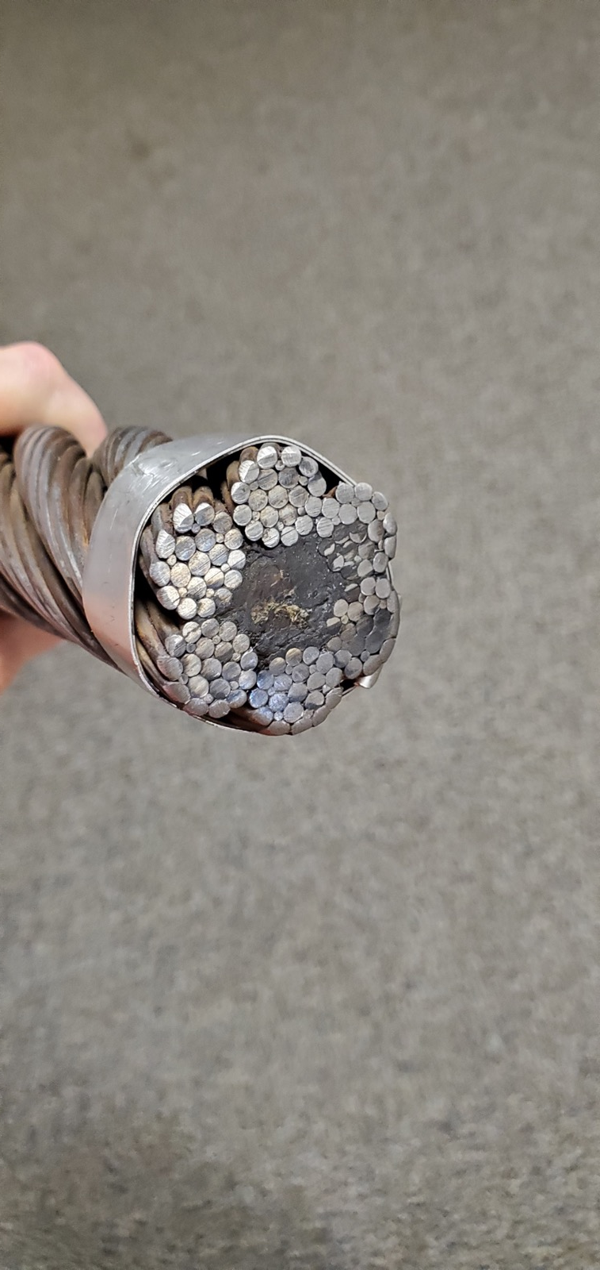
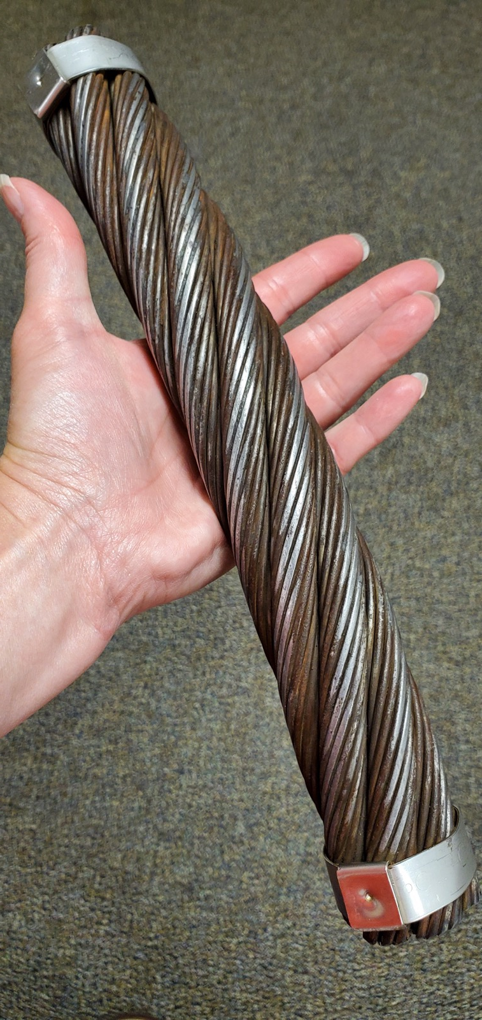
The
Yates
Rope
Notes:
It is a bit hard to see, but the ‘rope’ above has a hemp core (that has absorbed lots of mechanical grease- by design).
Fiber core steel wire ropes are generally more flexible and easier to handle than steel core wire ropes, making them ideal for use in applications where the rope may need to be bent or twisted frequently.
They are also less likely to fray or develop kinks than steel-core wire ropes, which can help to prolong their lifespan.
The rope that is used to lift and lower the Yates Cage is 1 & 5/8 inches in diameter and approximately 6,000 feet long!
The section above is 12 inches in length and weighs over 4 pounds

Slide 16
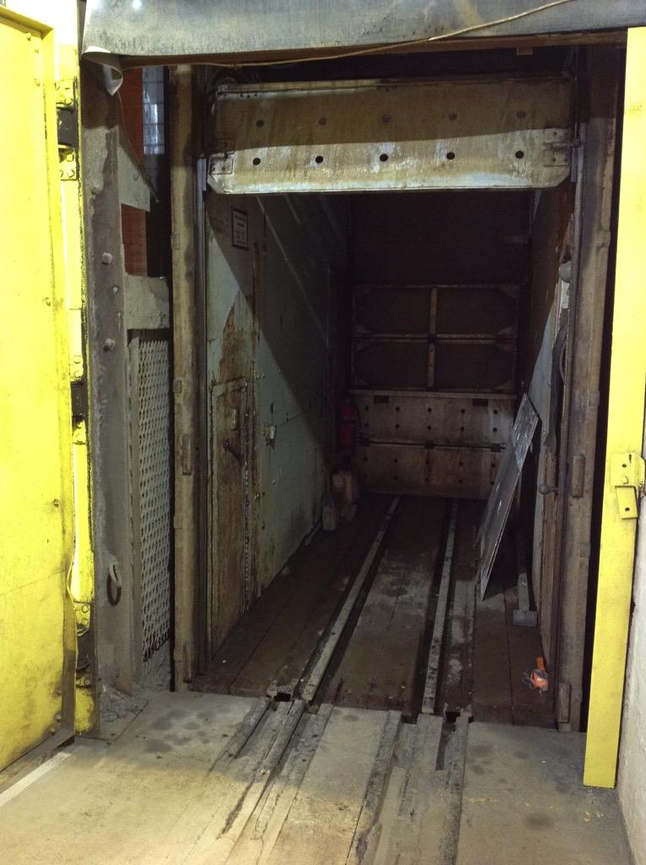
Notes:
What is the cage like?
(click picture to view video)
What would it be like to ride in the cage?
https://vimeo.com/458274125

Slide 17

QUESTIONS
Notes:
You may choose to share the 360 Hoistroom Tour from Neutrino Day 2020
https://vimeo.com/432389487

