Slide 1

Introduction to Engineering
Notes:
If the engineering design process document was homework…. What questions did you have?
What is Engineering?
Give students quiet time to think
Ask several students to share their definition of engineering
For example: Using science, mathematics and technology (and your imagination) to solve problems
Name something (not provided by nature) that is not engineered
Give students quiet time to think
Share one thing not engineered
Basically, all things around us (not provided by nature) are engineered. Engineering does not only apply to “complex” items or problems.
Let me see a thumbs up if you have designed or built something before…

Slide 2
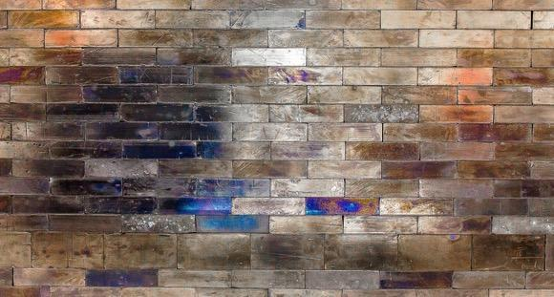
SHIELDING DESIGN CHALLENGE
Majorana Demonstrator
Notes:
Questions student should be able to answer after reading the
Shielding Design Challenge Student Sheet
Where is this experiment located?
4,850 feet underground in the Sanford Underground Research Facility (SURF)
What is this experiment looking for?
One of the rarest forms of radioactive decay--neutrinoless double beta decay.
What is the minimum required thickness of the lead shield?
Scientists working on the Majorana Demonstrator have determined that in addition to being almost one mile underground a minimum of 18 inches of lead brick will be necessary to sufficiently shield the detectors from outside sources of radiation.
What is the challenge?
The challenge in designing the enclosure will be to ensure that the bricks are stacked in such a way that no lines are created that could allow radiation from any source to reach the detectors.

Slide 3
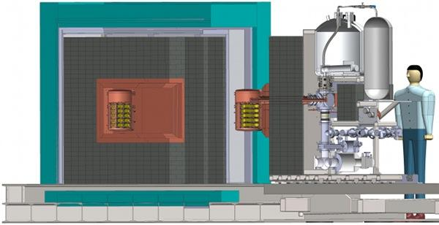
SIDE VIEW
A cross-section of the MAJORANA DEMONSTRATOR, showing installation of a cryostat module.
Notes:
A cryostat is an apparatus for maintaining a very low temperature.
The section on the right rolls up against the platform shield.
This allows the those working on the experiment to open and close the wall and still get access to the copper box in the center.
Pay close attention to the areas in dark gray—the brick enclosure.
(Next slide is not a diagram)
Background:
The Majorana Demonstrator (MJD) is looking for one of the rarest forms of radioactive decay-neutrinoless double-beta decay.
Its detection could help explain why matter—in other words, us and everything else in the universe—exists.

Slide 4
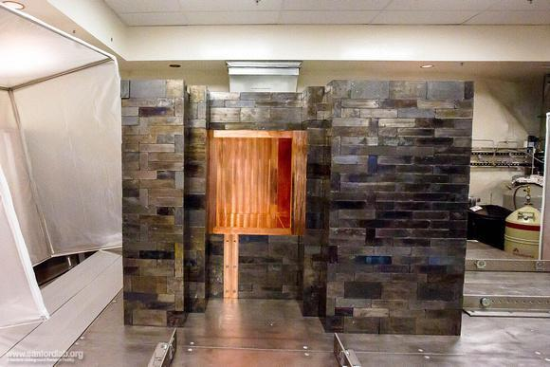
Notes:
Here you can see the track and the “notch” into which the apparatus slides to complete the shield.
The cryostat needs to be placed in the copper box.

Slide 5

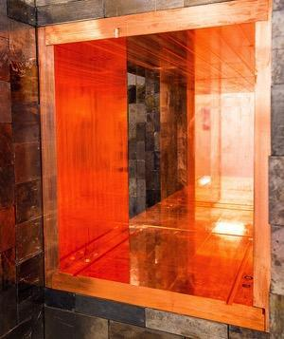
DO THE MATH
The box at the center of the shield is 28”tall x 40”wide x 24”deep
Given the need for the shield to be at least 18" in every direction,
that makes the outer dimensions…?
Notes:
Today- we will not be using metric measurements
(it will be easier to envision the parts if we are not busy converting)
But that does not mean that we will not be calculating!
The Cu box at the center of the shield is 28" tall, 40” wide and 24” deep
Do the math: Given the need for the Pb shield to be at least 18" in every direction, that makes the Pb shield outer dimensions…
I’m going to call out names on my screen to calculate
—tall---wide---deep.
Be prepared to share your work- not just your answer
This can be a sketch with calculations held up to the screen, entered in chat, annotated on screen, etc)
===================
For facilitator
(surrounding the Cu box) at least 64" tall, 76" wide x 60” deep

Slide 6
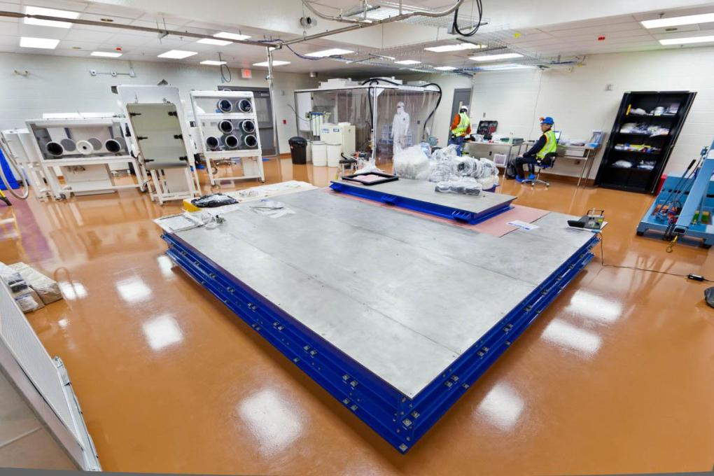
OVER FLOOR BASE
Notes:
Lead is heavy!
To avoid damaging the floor- a support was constructed.
The “over floor” base that will support the Majorana Demonstrator detector and its lead shielding. (144" x 144”)
How many feet x how many feet is that?
It is larger than needed, but it provides space to house some of the detector's vacuum and cryogenic equipment as well.

Slide 7
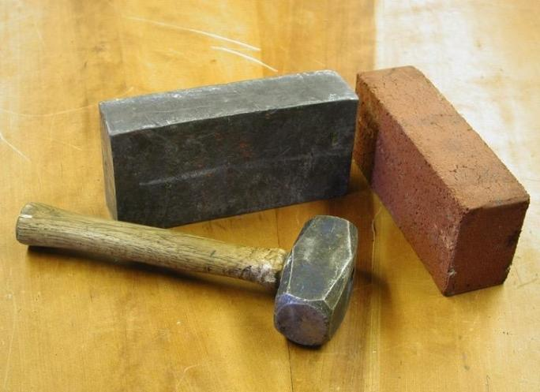
DO THE MATH
The average clay brick weighs 6 pounds, a lead brick the same size weighs in at a whopping 26.25 pounds!
If there are 4,120 lead bricks in the completed enclosure,
what is their weight in tons?
Notes:
Do the math:
While the average clay brick weighs 6 pounds, a lead brick the same size tops the scales at a whopping 26.25 pounds!
If there are 4,120 lead bricks (full brick equivalent) in the completed enclosure, what is their weight in tons?
Give students time to calculate!
Show work in chat- do not hit enter until I say go.
4,120 X 26.25 lbs= 108,150 lbs
108,150 lbs/2000= 54.075 Tons (*100,000 approx. weight of a Boeing 737) Think about a plane that is carrying about 150 people!!
Some of our bricks are not the full size and many (almost 16%) are half of the normal size. (this might be a good piece of information for the challenge, in order to keep to the specified size, we found that we regularly needed to use a half-brick in spots and other fractional sizes where needed)
5200 bricks is actually the number of "pieces" we needed where some are fractional sizes of a full brick.
For the record, here is the official count, where I count in "Full brick equivalent", which is the number of bricks needed if only full (normal) sized bricks were used.
The completed stack (as it looks now) with the two openings missing their bricks: 3130 Full Brick Equivalent
The completed stack when the two opening are filled with the cryostat and remaining Pb bricks: 4120 Full Brick Equivalent

Slide 8
YOUR TASK
Your task is to design an enclosure that limits alignment of brick edges, by staggering bricks both horizontally and vertically.
Brick edges should not line up in adjacent layers.

Slide 9
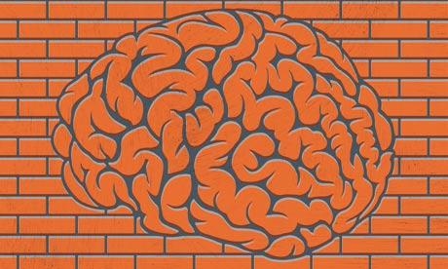
IDENTIFY, IMAGINE, DESIGN
Notes:
What could you use to represent the lead bricks?
Give students time to think, then ask for a few ideas
What problems would there be if you were to build a traditional brick pattern wall for each layer? (every place the seams line up creates a clear path for radiation to pass through the enclosure)
List other obstacles you may encounter.
Explore patterns that incorporate bricks in various orientations.
Brainstorm possible solutions for this structure.
Choose your best design option and draw/create a diagram of your idea.

Slide 10
What questions do you have about the task?
Notes:
We have identified the problem.
Imagine- brainstorm many possible solutions and materials
Design- choose a solution to prototype stacking arrangement/configuration
What do you do next?

Slide 11
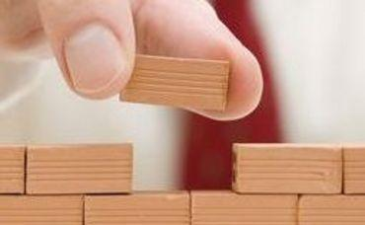
CREATE
Notes:
Begin constructing your prototype according to your design plan.
Considering your scale model, how many layers would it take to produce an equivalent of at least 18 inches of shielding?
*The dimensions of a typical lead brick are the same as those of a typical clay brick (2in x 4in x 8in).
How many bricks would be necessary to complete the structure? (Answer to MJD solution on design challenge sheet) 4120
NOTE: you may not have the time, or access to the required amount of material to build a complete prototype. Focus on a few layers.

Slide 12
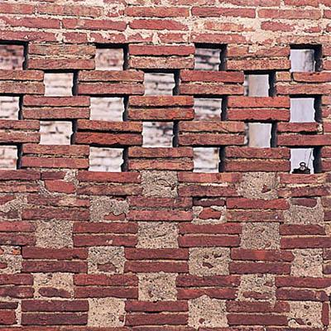
TEST AND EVALUATE
Notes:
When you have completed a representative portion of your model, scrutinize your structure.
Do any of the edges line up, allowing radiation to reach the interior?
If something isn’t working, go back and revise your design plan.

Slide 13
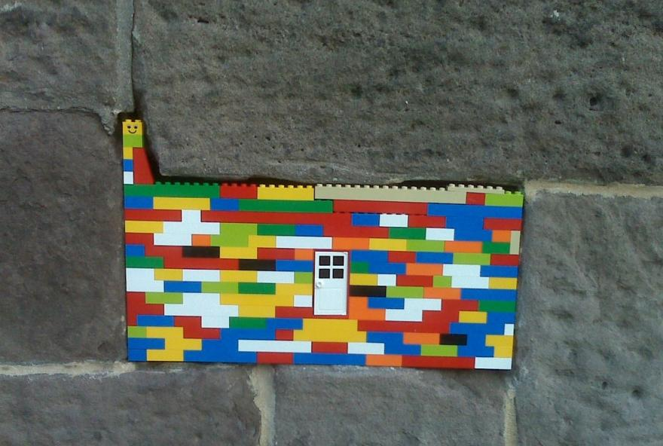
IMPROVE
Notes:
You will likely test your stacking pattern—find issues—make improvements—test your new pattern—find new issues—make more improvements—and so on, before you call your design a success.

Slide 14

Notes:
I encourage you to share your design with someone at home
Next week….Share designs with your classmates.
Which building material did you choose?
Was it necessary to revise your original design idea? If so, which of your designs performed the best?
Now that you have some experience, what might you change to optimize shielding?
Now that you have shared your findings with each other, how might you select certain aspects from multiple designs and combine them to create a super structure? What might that look like?
Optional- share pictures of design on padlet
Tell about 1 challenge
https://padlet.com/4science/MJD
Password: brick

Slide 15
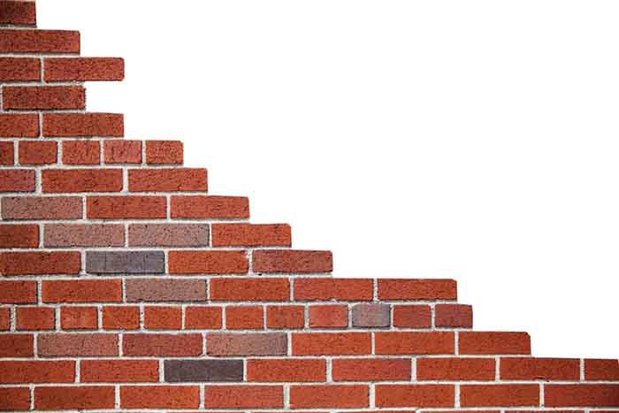
UNTIL NEXT TIME!
Notes:
Can’t wait for some of you to share your design solutions!
I will also have lots of pictures to share that show the MJD solution.

Slide 16
Part 2

Slide 17
Notes:
Last week designed/built …Ready to Share??
Which building material did you choose?
Was it necessary to revise your original design idea? If so, which of your designs performed the best?
Now that you have some experience, what might you change to optimize shielding?
Now that you have shared your findings with each other, how might you select certain aspects from multiple designs and combine them to create a super structure? What might that look like?

Slide 18

Our Solution

Slide 19
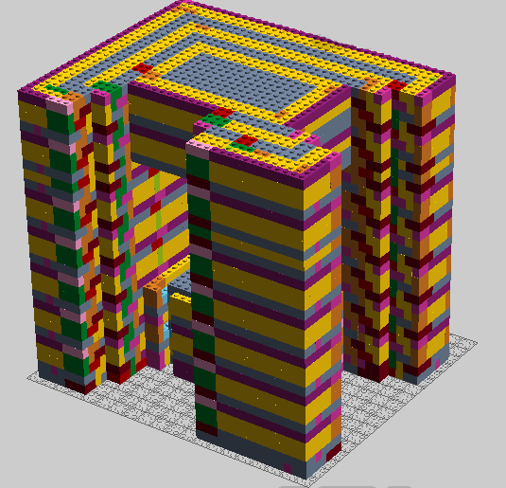
IMAGINE
Notes:
Imagine
Lego Digital Designer was used to visualize

Slide 20
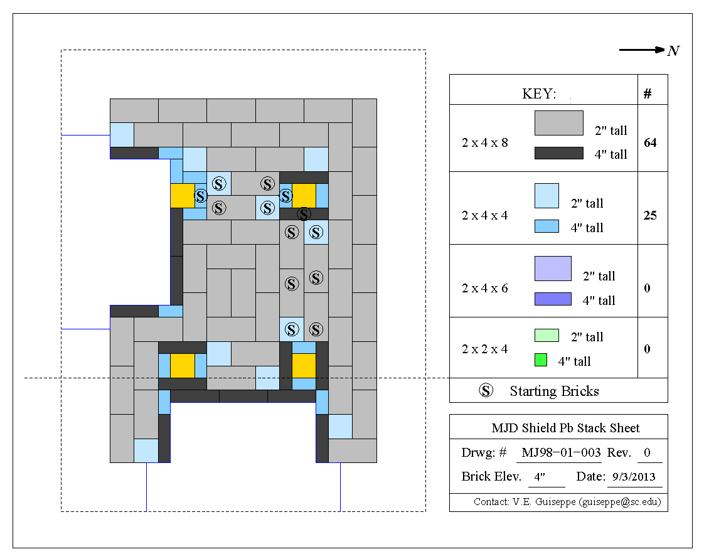
DESIGN

Slide 21
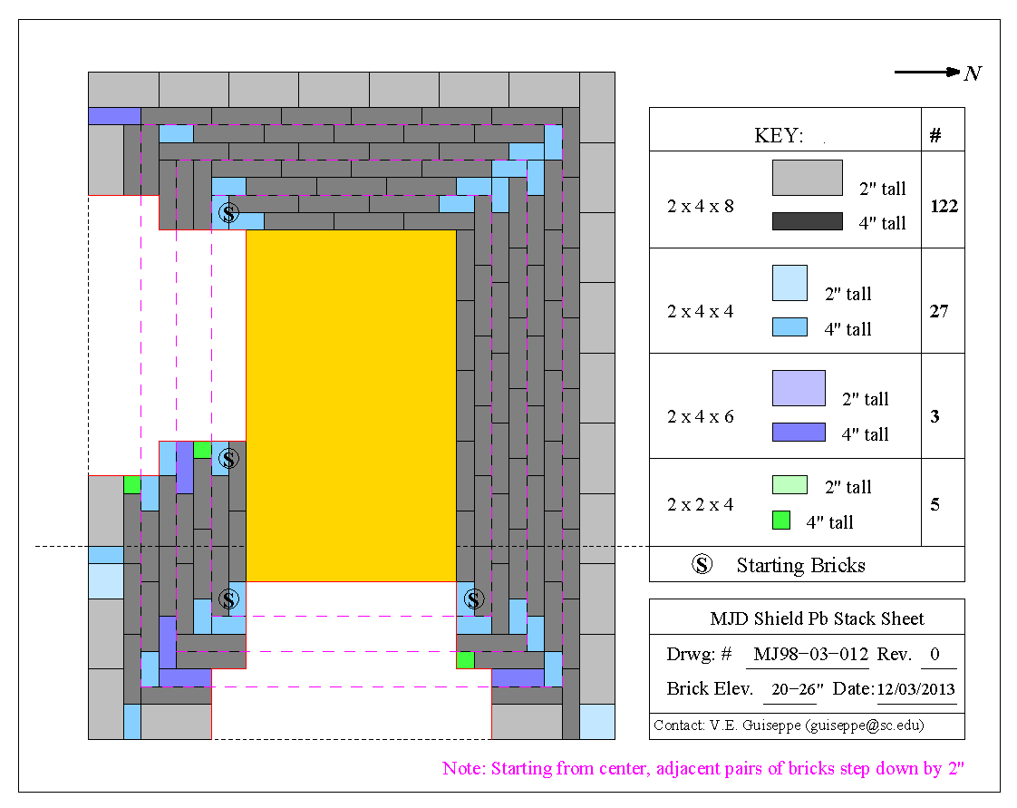
DESIGN
Notes:
Very complex
Required plan to build carefully level by level
Required build sheets
Note- need for partial bricks (scientists decided that they wanted a ‘smooth’ exterior surface

Slide 22
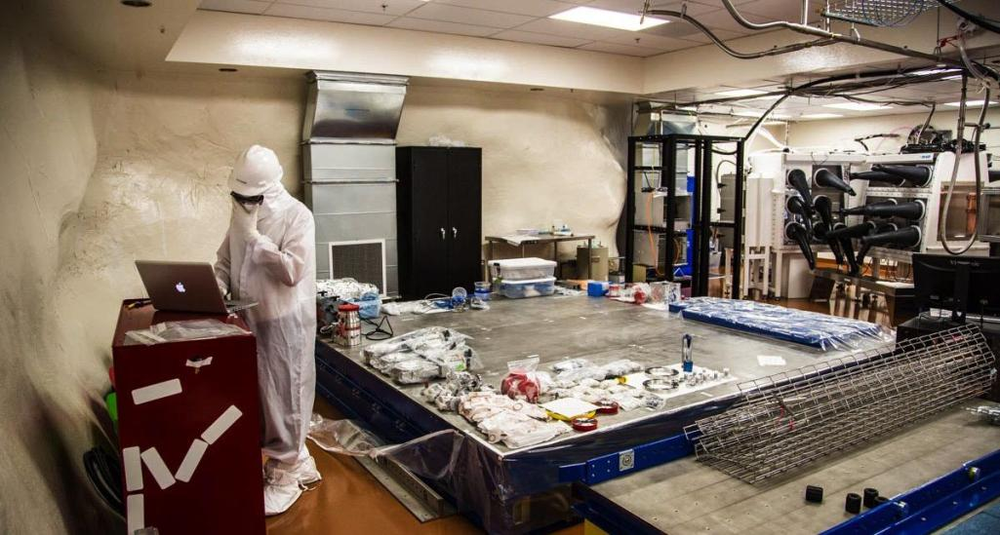
STAGING

Slide 23
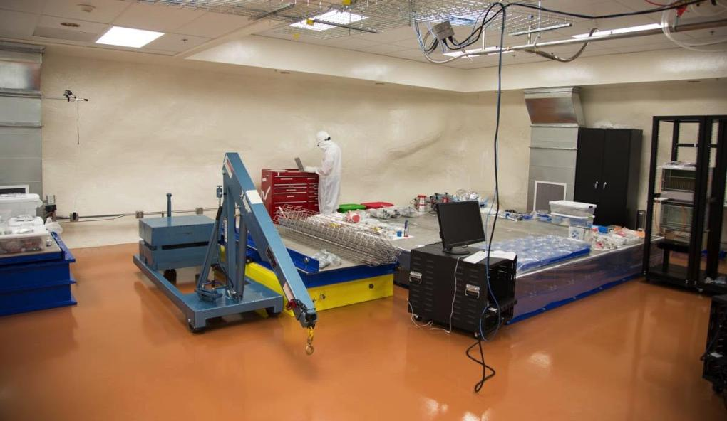
STAGING

Slide 24
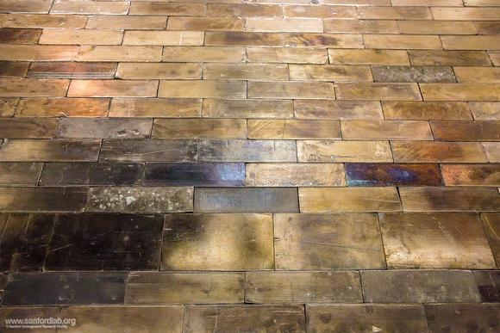
WHAT IT LOOKS LIKE

Slide 25
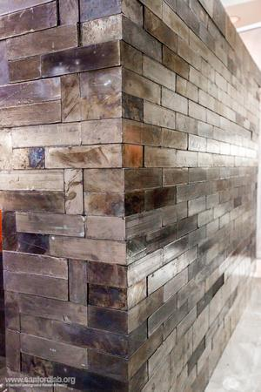

Slide 26
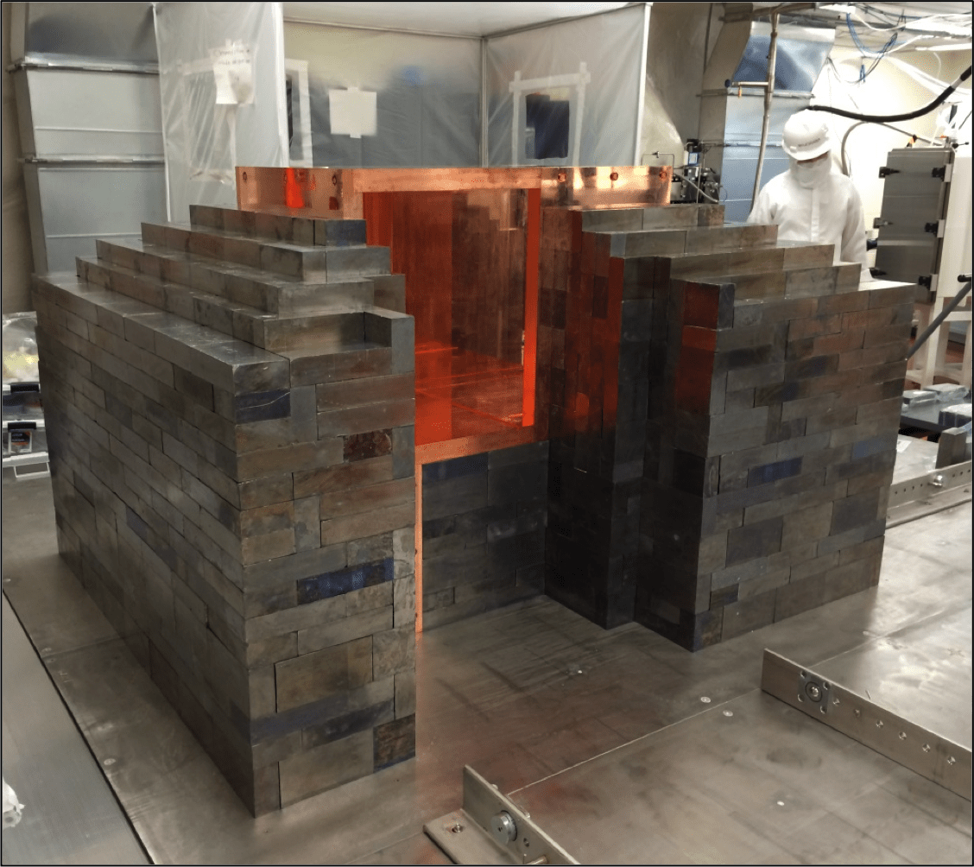

Slide 27
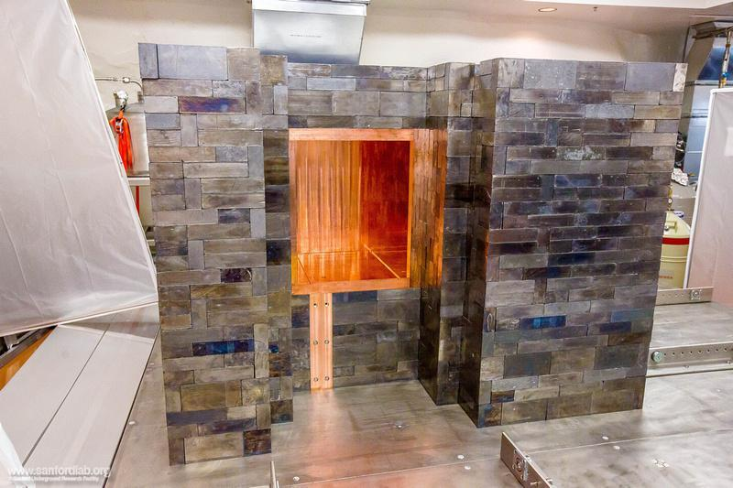

Slide 28
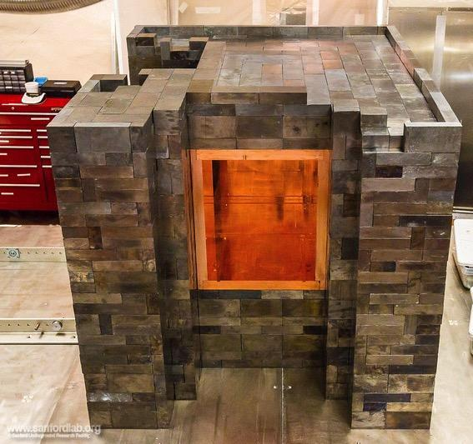

Slide 29
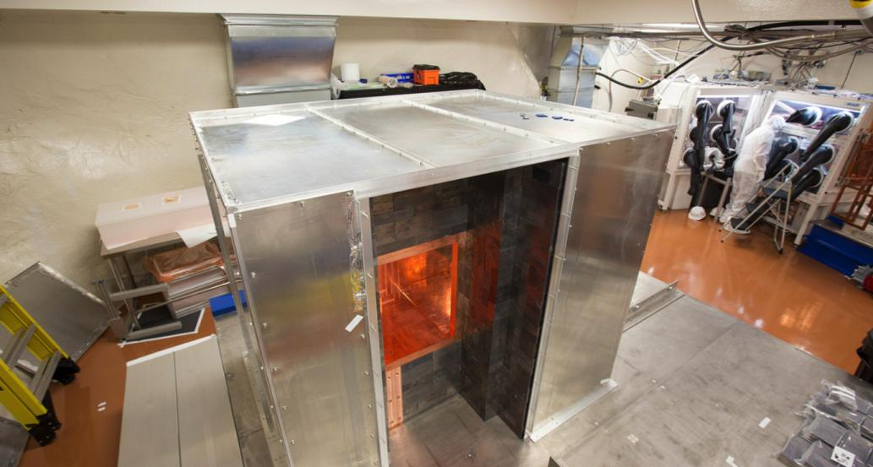

Slide 30
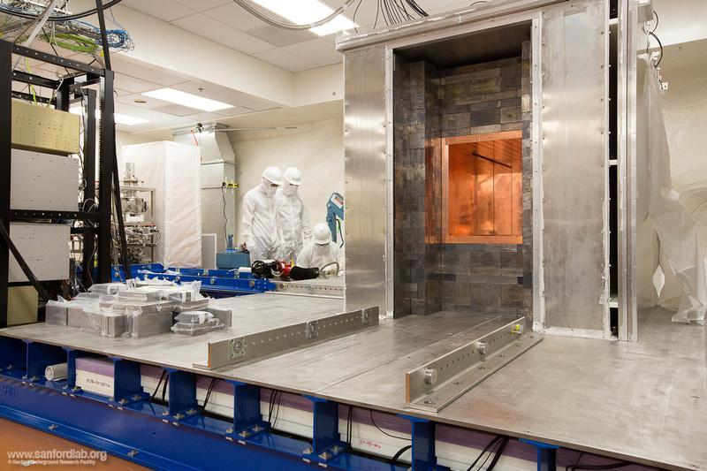

Slide 31
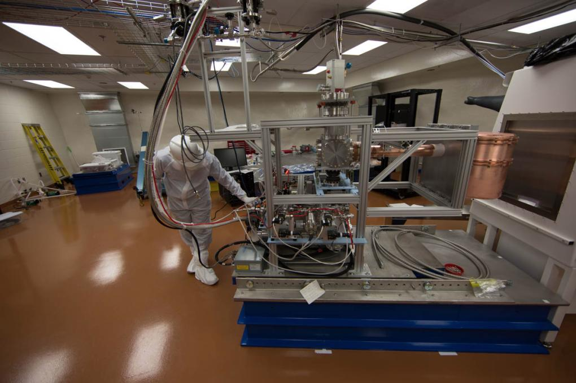
Notes:
Time lapse- Building the Majorana Demonstrator
https://vimeo.com/134224224

Slide 32
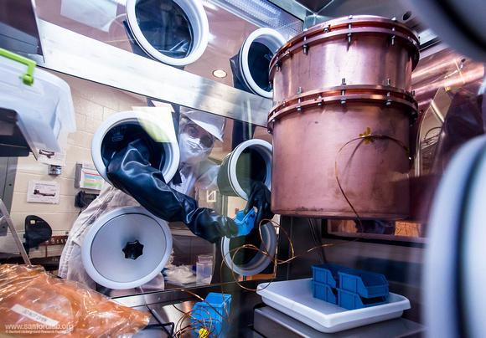

Slide 33

QUESTIONS

